Slide 1




International Conference on Gender and Diversity – ICMS 47
Gender, Power, Belonging, and Justice.
Diversity and Equality in the Georgian Education System: A Gender-Focused Analysis
Ekaterine Gulua
PhD in Economics, Assistant Professor, founder of HPM, Ivane Javakhishvili Tbilisi State University (TSU)
Brussels 26–27 March 2026

Slide 2
Structure:
Introduction
Literature Review:
Identification of Types of Diversity
Determinants of Diversity Perception
Mechanisms for Managing Equality
Methodology: Empirical analysis, qualitative and quantitative research based on a secondary desk review, as well as focus group research involving two target groups
Results
Discussion
Summary

Slide 3

The Economic Importance of Gender Equality in Education
Economic Growth and Productivity -
Educating girls increases labour productivity and contributes to higher GDP per capita.
Poverty Reduction and Higher Earnings -
Equal access to education helps reduce poverty and increases women’s future earnings.
Health and Labour Market Development -
Female education improves public health, and strengthens labour markets.
https://eige.europa.eu/newsroom/economic-benefits-gender-equality?language_content_entity=en
Societal and Structural Benefits
Education helps break gender stereotypes and encourages greater participation of women in the workforce.
Gender-equitable education develops critical skills and promotes diversity, which increases innovation and improves problem-solving.
https://unitedwaynca.org/blog/importance-of-gender-equality/#:~:text=Gender%20equality%20is%20a%20fundamental%20human%20right,more%20likely%20to%20make%20healthier%20life%20choices.

Slide 4
Identity-aware/
Multiculturalism
Identity-blind/
Colorblindness
Focusing on Differences Between Groups
Recognition of Diversity;
Management of Diversity;
Protection of Minority Rights, Including Through Quotas
Focusing on Similarities Between Groups
Ignoring Differences between Individuals and Groups
Managing Instead by Focusing on Shared Characteristics
Ensuring equity and equal protection of rights for all.

Slide 5
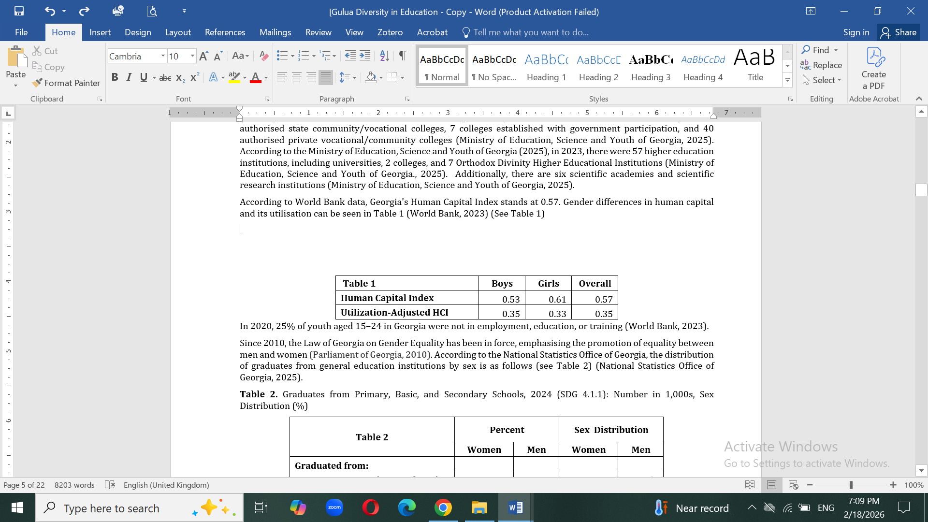

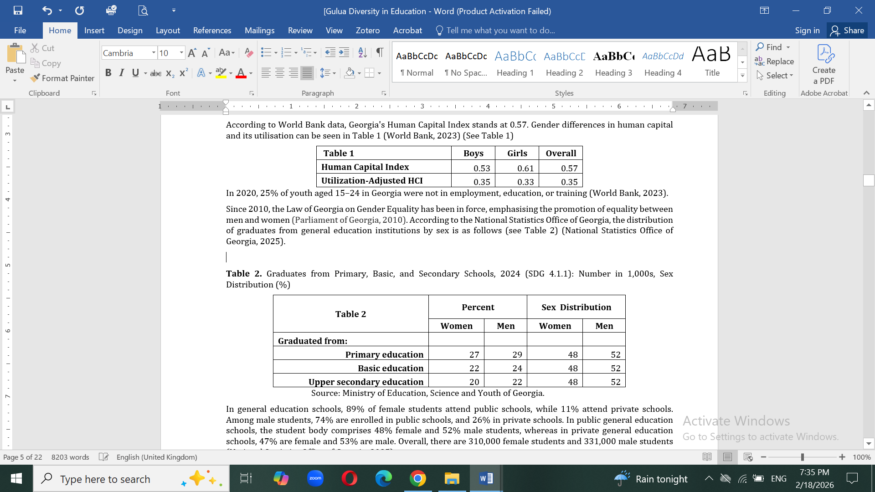
Table 1. Georgia's Human Capital Index
Table 2. Graduates from Primary, Basic, and Secondary Schools, 2024 (SDG 4.1.1):
Number in 1,000s, Sex Distribution (%)

Slide 6
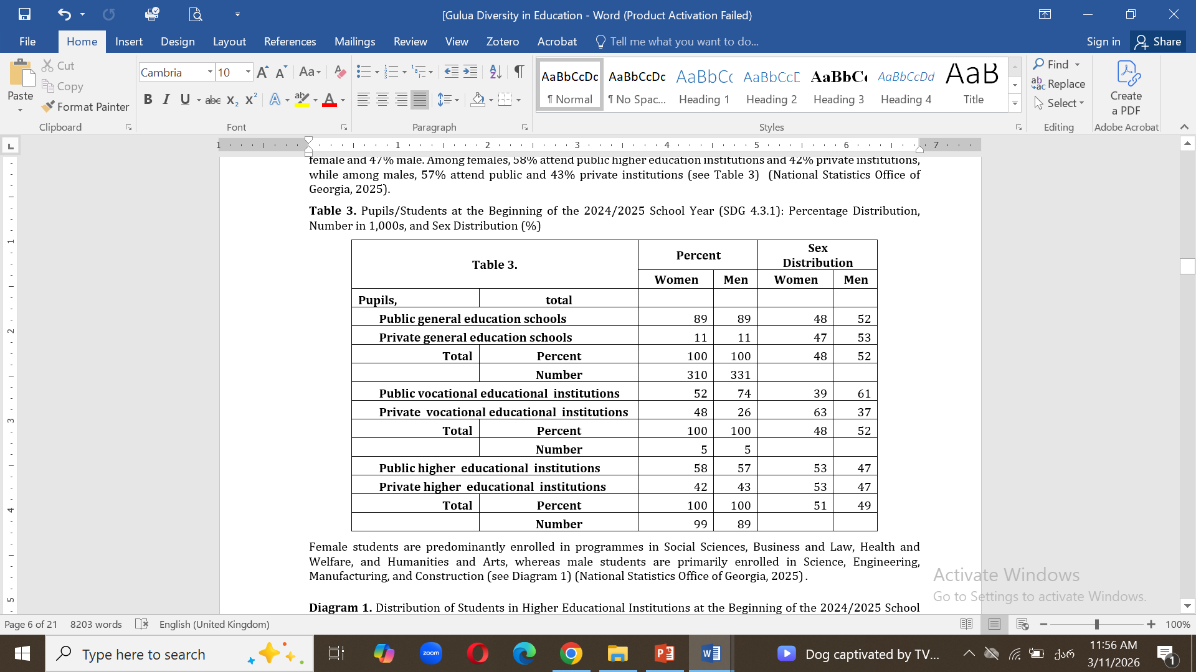
Table 3. Pupils/Students at the Beginning of the 2024/2025 School Year (SDG 4.3.1):
Percentage Distribution, Number in 1,000s, and Sex Distribution (%)

Slide 7
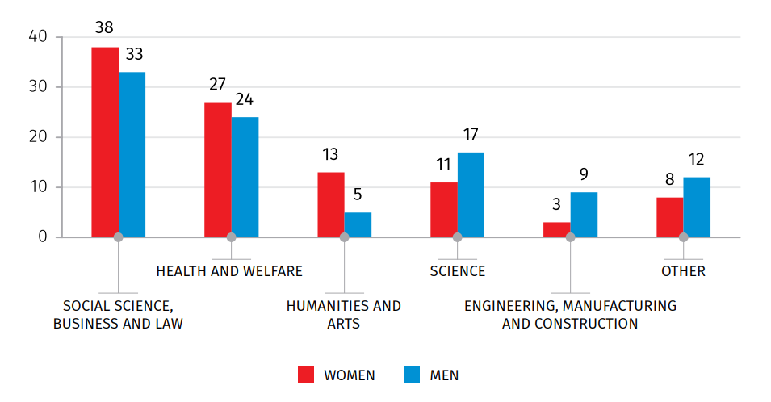
Diagram 1. Distribution of Students in Higher Educational Institutions at the Beginning of the 2024/2025 School Year by Programmes (%).

Slide 8
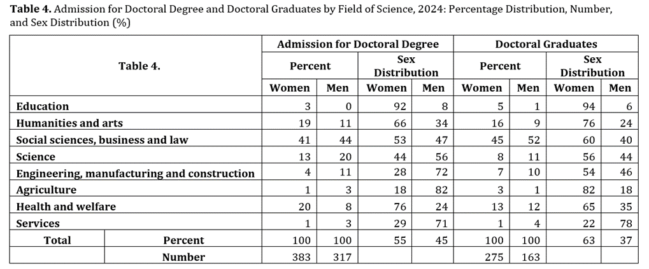
Table 4. Admission for Doctoral Degree and Doctoral Graduates by Field of Science, 2024: Percentage Distribution, Number, and Sex Distribution (%)

Slide 9
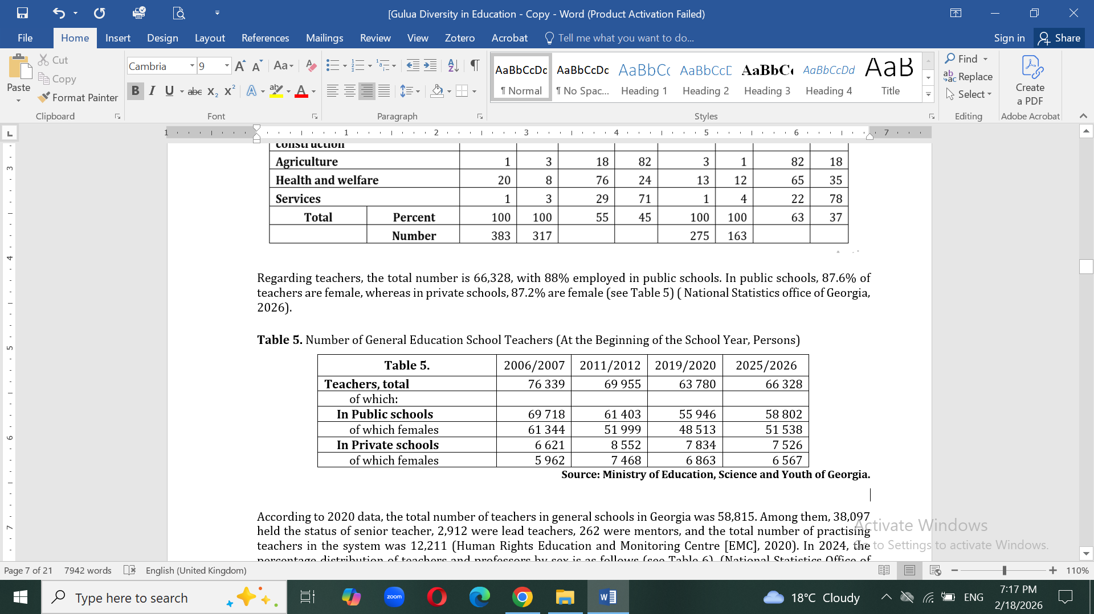
Table 5. Number of General Education School Teachers (At the Beginning of the School Year, Persons)

Slide 10
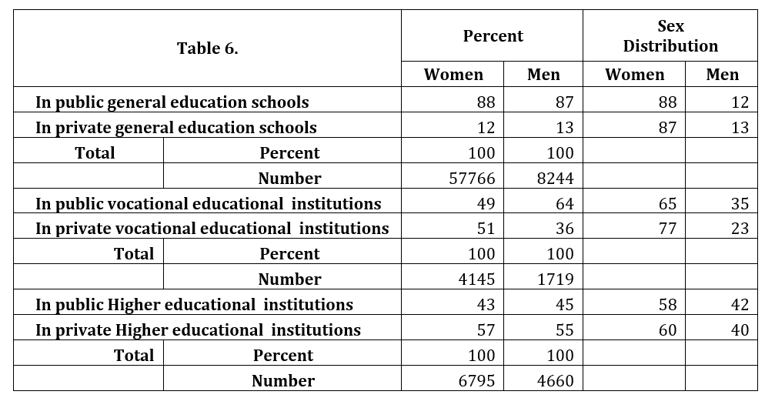
Table 6. Teachers/Professors at the Beginning of the 2024/2025 School Year: Percentage Distribution, Number, and Sex Distribution (%)

Slide 11
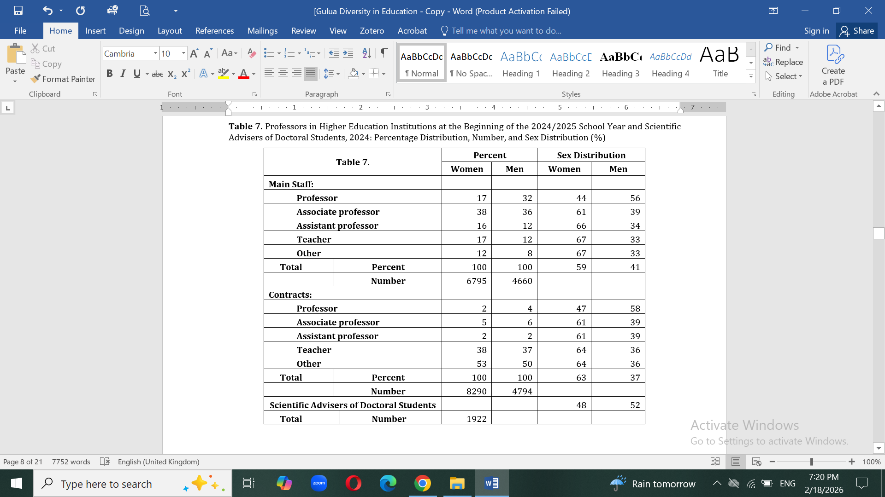
Table 7. Professors in Higher Education Institutions at the Beginning of the 2024/2025 School Year and Scientific Advisers of Doctoral Students, 2024: Percentage Distribution, Number, and Sex Distribution (%)

Slide 14
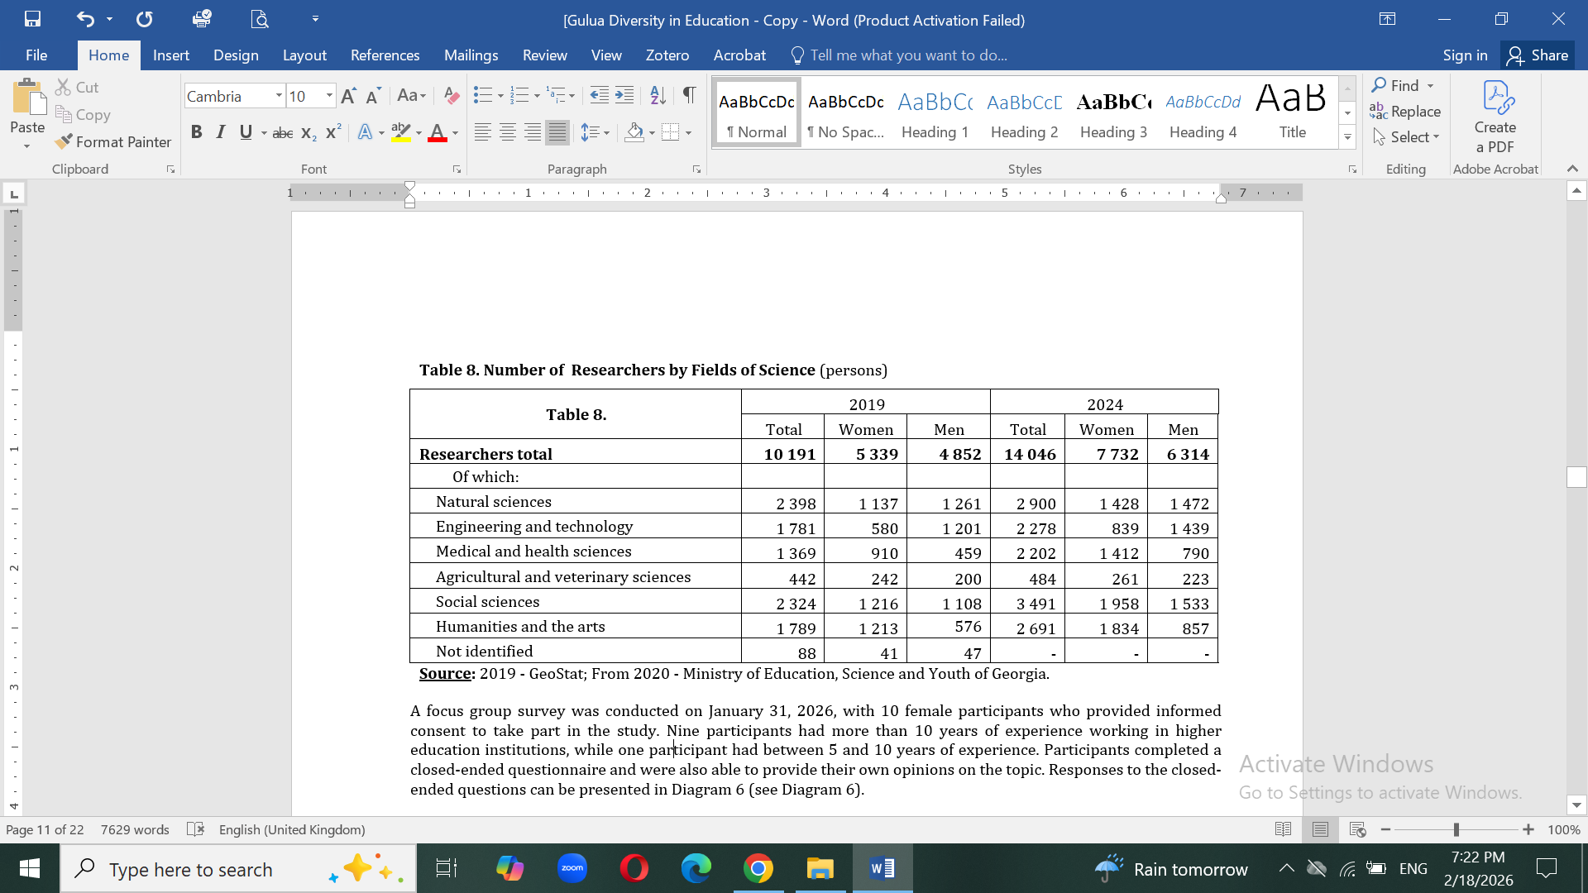
Table 8. Number of Researchers by Fields of Science (persons)

Slide 15
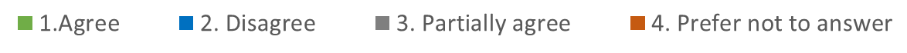
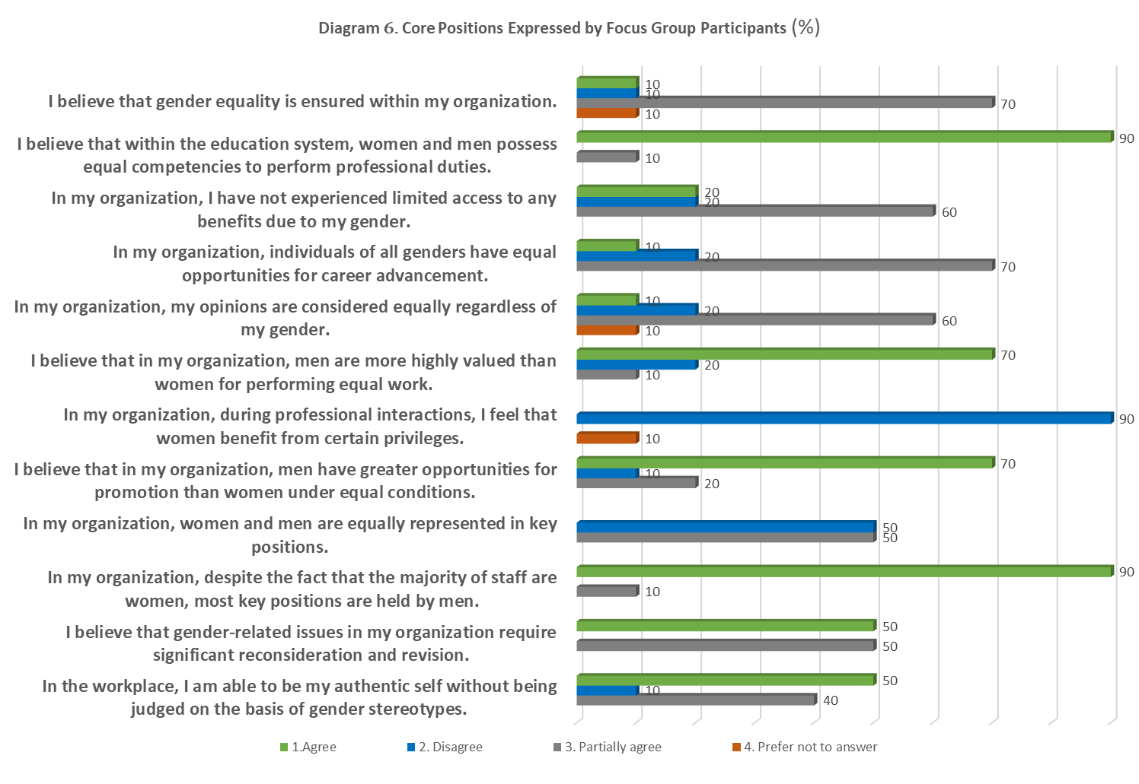
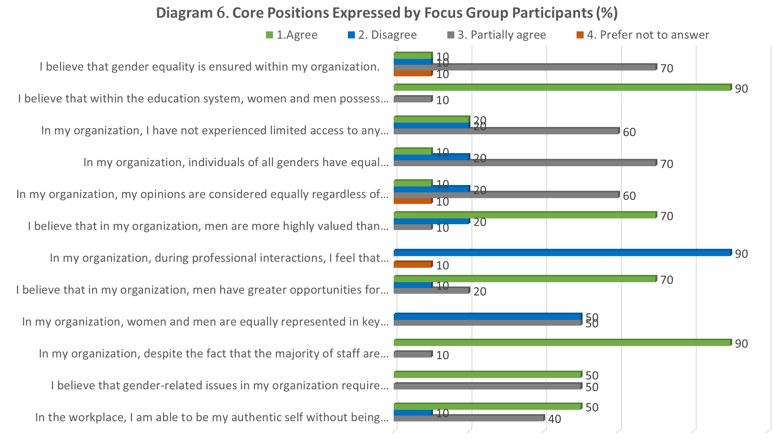
Diagram 6. Core Positions Expressed by Focus Group (1) Participants (%)
Focus Group 1

Slide 16
Diagram 6. Core Positions Expressed by Focus Group (1) Participants (%)
Focus Group 1

Slide 17
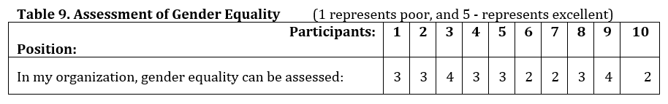
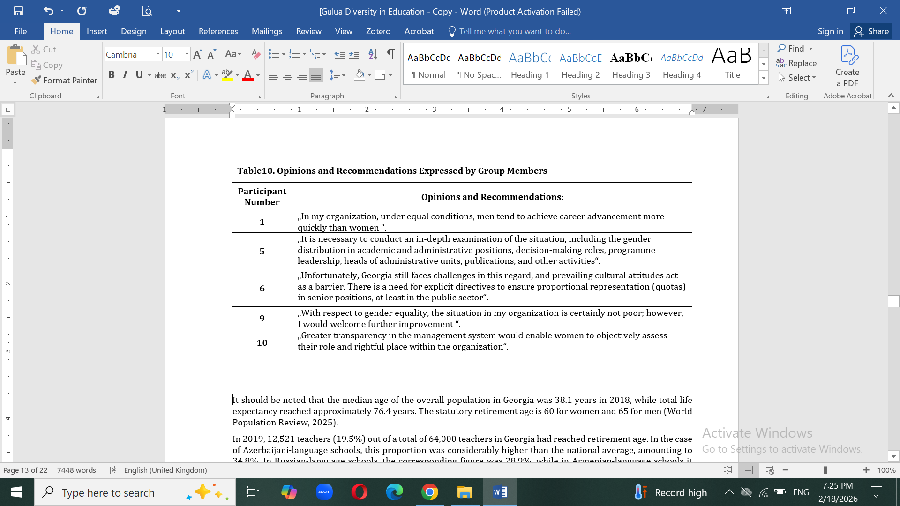
Focus Group 1

Slide 18
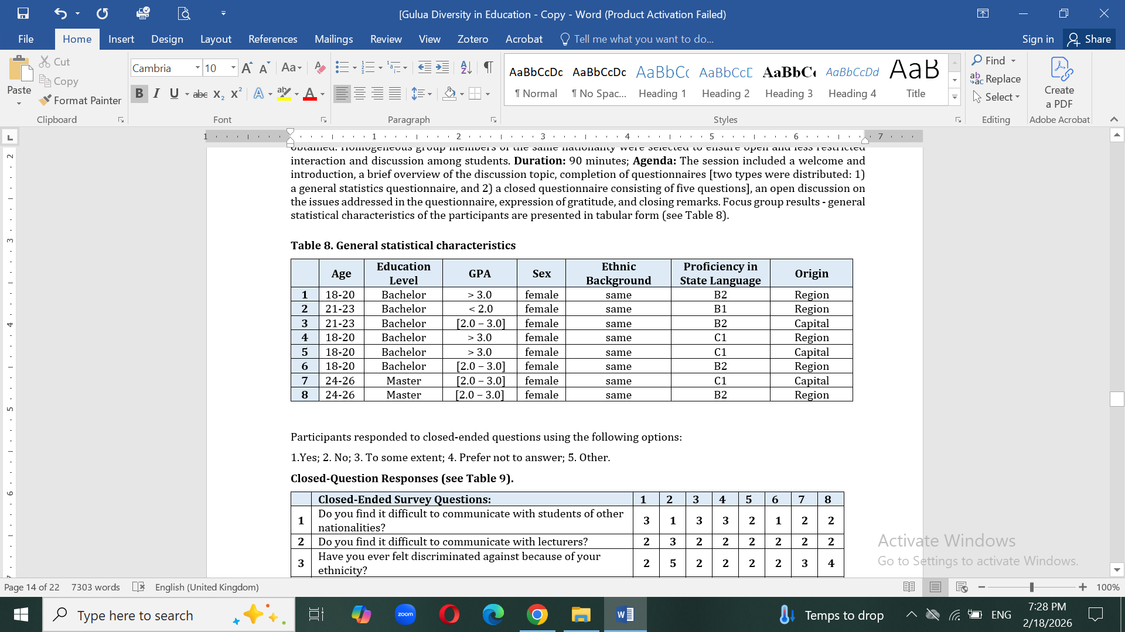
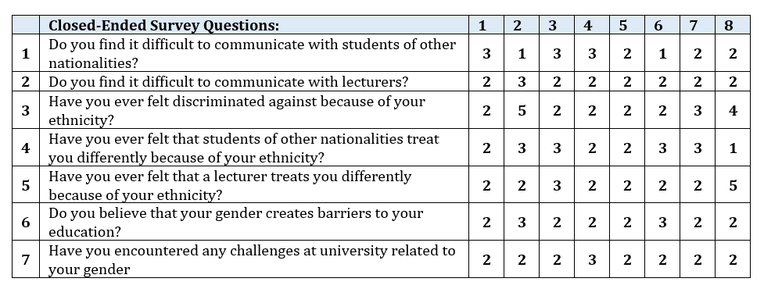
Focus Group 2

Slide 19
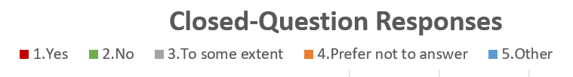

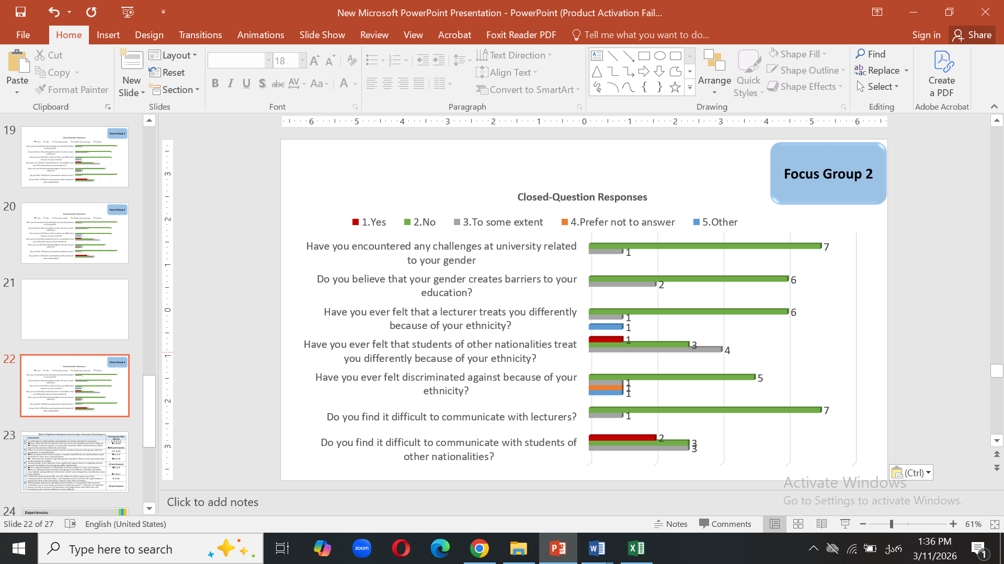

Slide 20
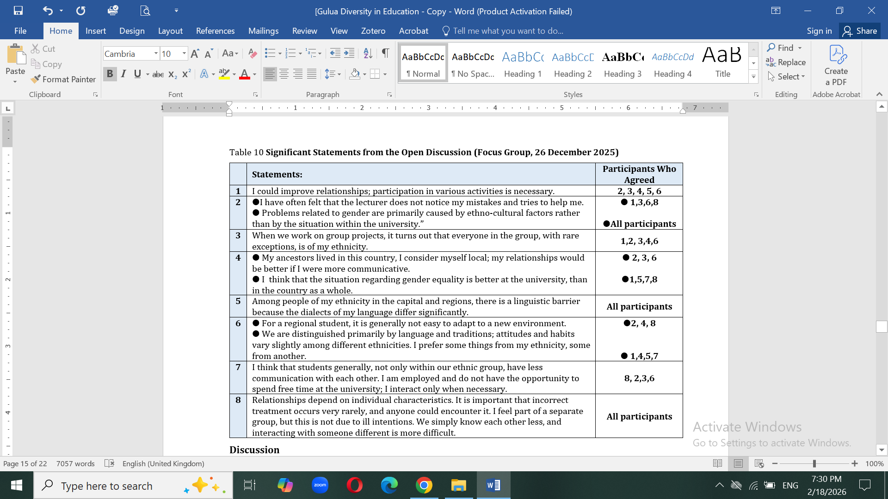
Table 10 Significant Statements from the Open Discussion (Focus Group 2.)

Slide 21
Experiences:
Educational programmes that encourage discussion and reflection on different perspectives help reduce stereotypes and promote positive attitudes towards diversity (David S. Gurin et al., 2002; Weiss et al., 2023).
Providing accurate information and correcting stereotypes helps reduce stigma and biased perceptions among students (Nasie, 2025; Selisko et al., 2024).
Education that promotes diversity and equality improves critical thinking and prepares students for working in diverse environments, which is increasingly demanded by modern organisations (Eric L. Bowman, 2010; Meric et al., 2015).

Slide 22






Experiences:
Integration of Strategic Gender Policies in Educational Institutions
Iceland – Implementation of gender equality strategies in schools and universities.
Finland – Equal participation of girls and boys at all educational levels.
Monitoring and Assessment of Gender Representation
Norway – Regular monitoring of gender statistics in schools and universities.
Canada – Evaluation of girls’ participation in STEM programmes.
Support for Girls in STEM Education
Rwanda – STEM programmes for female university students.
Canada – Scholarships and mentoring programmes for girls.
Inclusive Career Development and Pay Equity Programmes
Iceland – Pay equity certification in educational institutions.
Sweden – Ensuring pay transparency in universities and organisations.

Slide 23
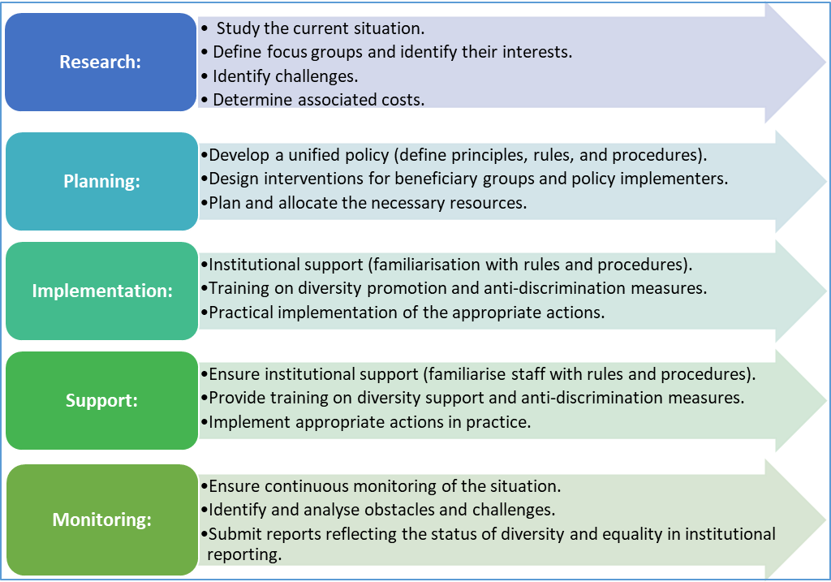
Schema 1. Diversity Management Model

Slide 24
Summary:
Georgia’s legislative framework supports equality in education; however, the key challenge remains the elimination of tokenism and the transition from symbolic approaches to the genuine experience of equality.
This requires the introduction of identity-aware approaches and mechanisms for safeguarding the interests of minority groups, which could later enable the implementation of an identity-blind approach.
At both school and higher education levels, the proportion and participation of women are high. A similar pattern is observed among teachers and academic staff. Nevertheless, it is evident that men aged 65 and over constitute a privileged category, both among researchers employed in full-time academic positions and those engaged on a visiting basis, as well as among those holding the rank of full professor.
This conclusion was also expressed during the focus group discussion: “In my organisation, under equal conditions, men tend to achieve career advancement more quickly than women.”
In general, gender inequality is not strongly perceived within schools and universities; such issues may more often arise within the family environment. It is also noteworthy that the National Statistics Office of Georgia reports that male students more frequently discontinue their studies in order to enter the labour market and financially support the education of their sisters.
Current trends indicate a growing representation of women within the education system. Alongside generational and attitudinal shifts, as well as increasing transparency in governance, these challenges are likely to become progressively easier to address.

