Slide 1

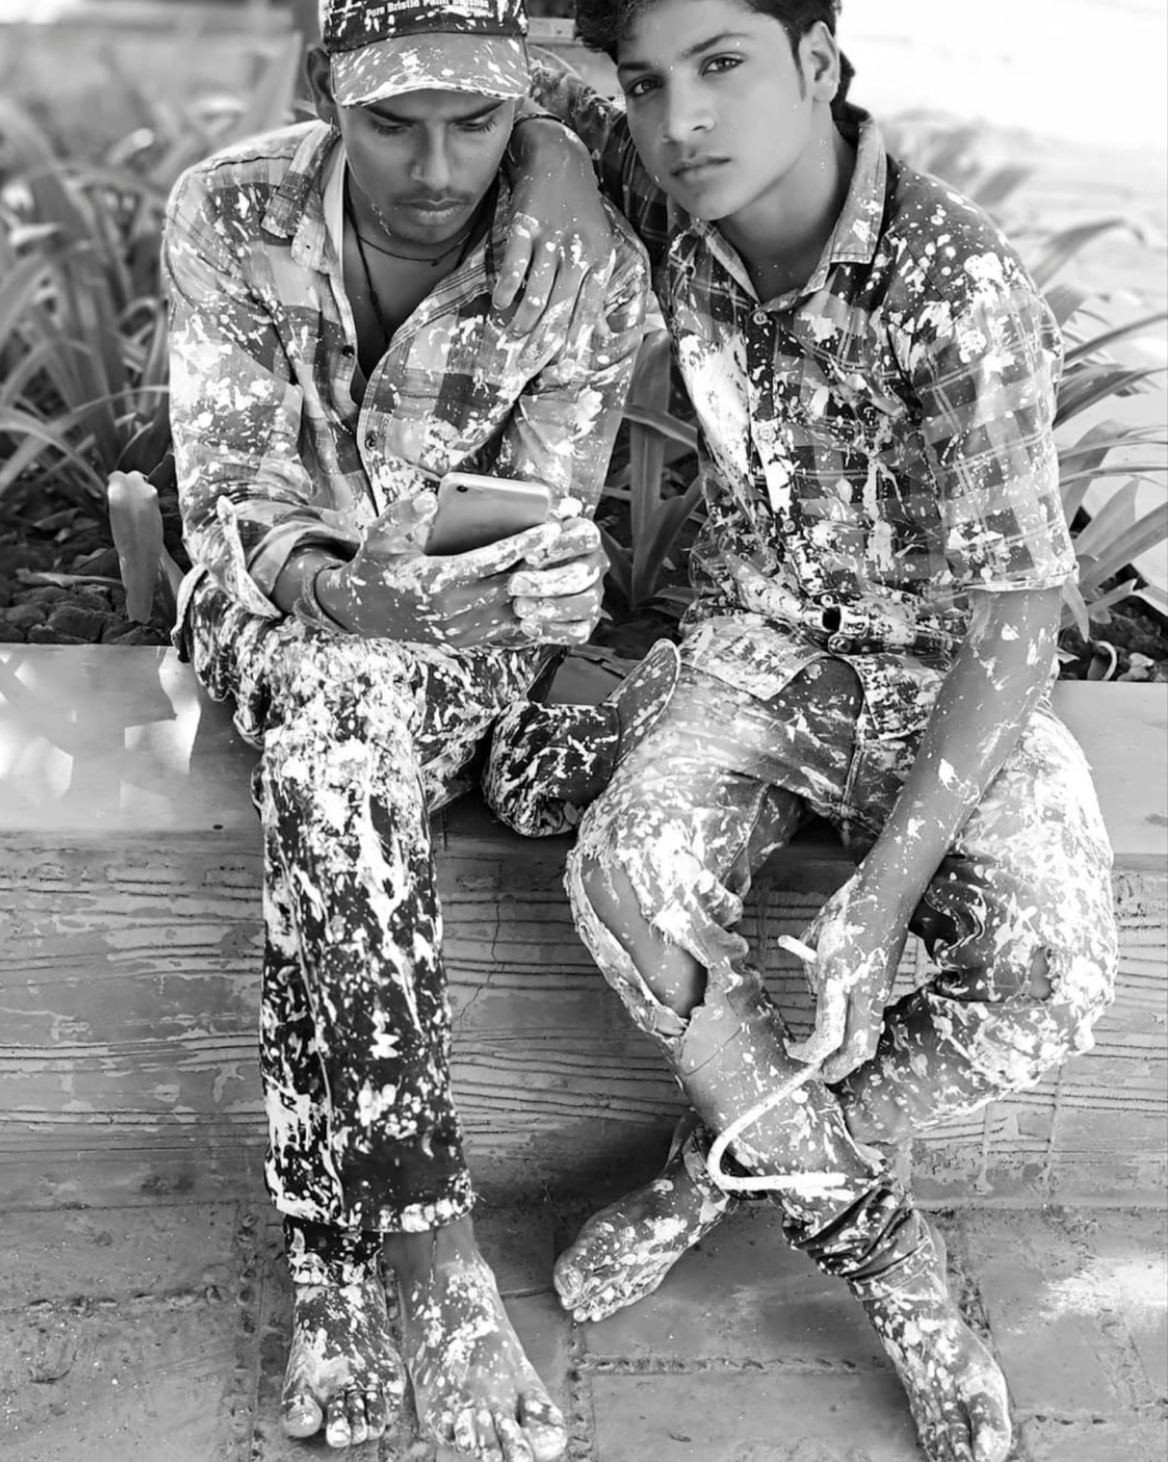
Queering Masculinities:
Homosocial Desire
and
Men’s Self-Fashioning in India
Prof. Dr. Marius Janusauskas
Literary Studies | Ghent University | marius.janusauskas@ugent.be
Photo: Nandita Shah “Kalarwale (2018)

Slide 2
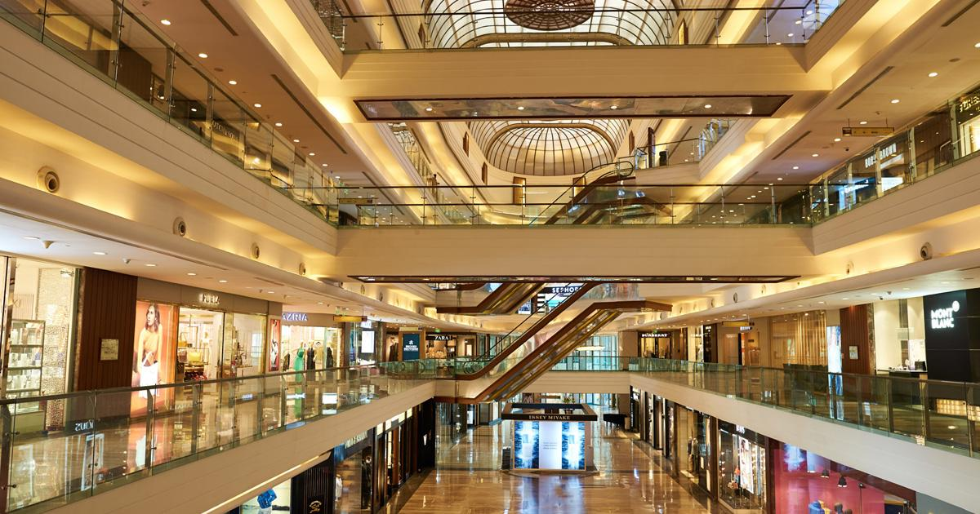
Fashioning Masculinities in Modernity
The colonial imprint on Indian masculinity (Kabesh 2013)
Modern cultures of masculinity (Srivastava 2014)
A crisis of masculinity (Banerjee 2005, 2006; Chakraborty 2024)
The cultural logics of male-to-male spaces (Sedgwick 1985)
Photo: Phoenix Palladium Mumbai

Slide 3
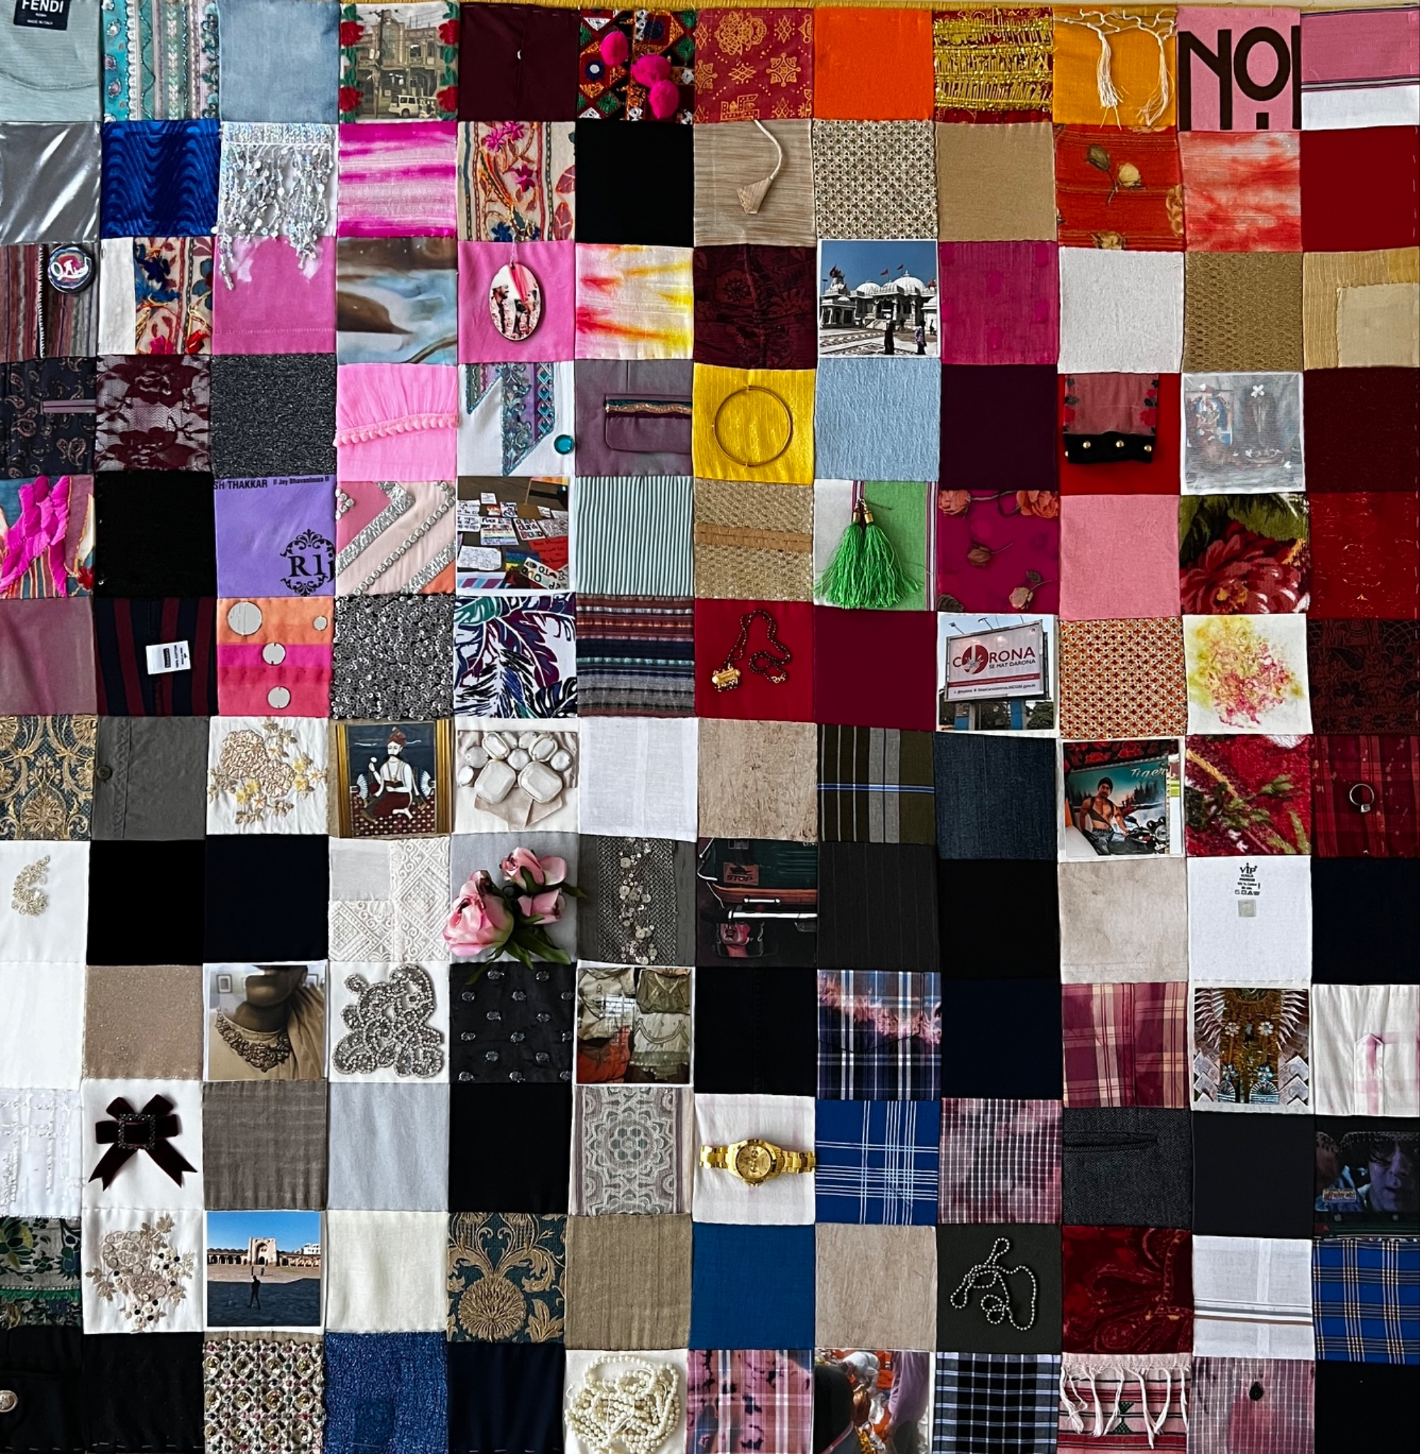
Theoretical Framework
Queer patchwork (Dasgupta 2022)
Fashion ethnography (Tarlo 1996)
Queer phenomenology (Ahmed 2006)
Decolonial thinking (Mignolo & Walsh 2018)
Photo: Patchwork design serves as a visual note-taking tool, blending social realities with fashion practices (Janusauskas 2024).

Slide 4
Research Question
How do collective men’s self-fashioning practices in post-colonial India shape power and belonging in homosocial spaces?
How do these practices reinforce and unsettle heteronormative, caste, class, and sexual hierarchies?

Slide 5
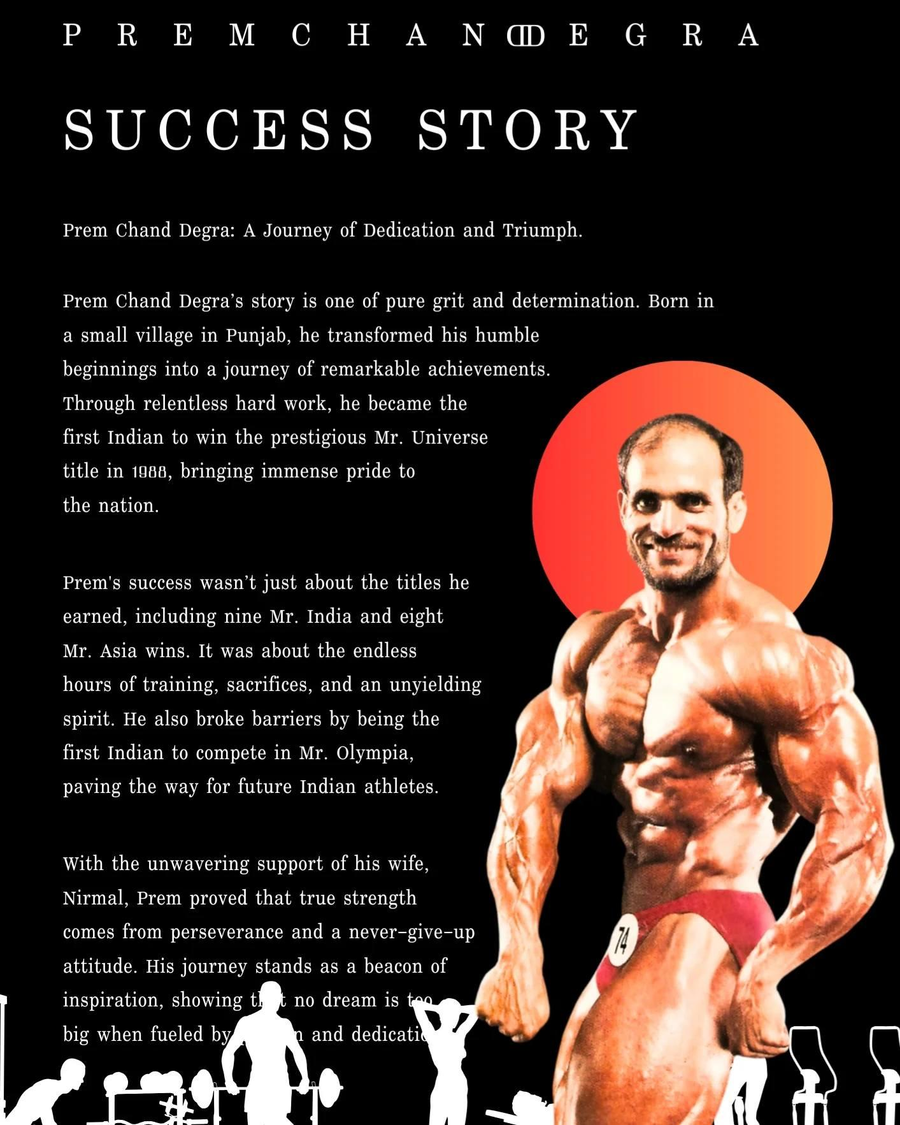
Hard Bodies in Indian visual media
The “Sandowian model” of masculinity (Conrad 2021)
A muscular body in consumerist practices (Alexander 2003)
Dominant stereotypes of masculinity (Srivastava 2014; Gupta 2016)

Slide 6
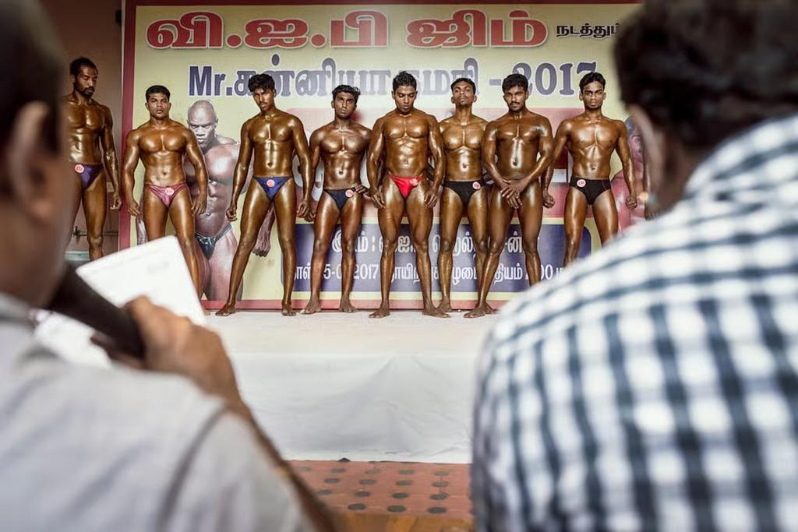
Hard Body Masculinity
a casteless position
social fluidity (urban spaces)
homosocial bonds
the homoerotic gaze
Photo: A scene from the 2018 documentary Tight(ish), dir. Elliott Gonzo. The film shows Indian men turning away from tradition and competing for a better life, even at the cost of their health.

Slide 7
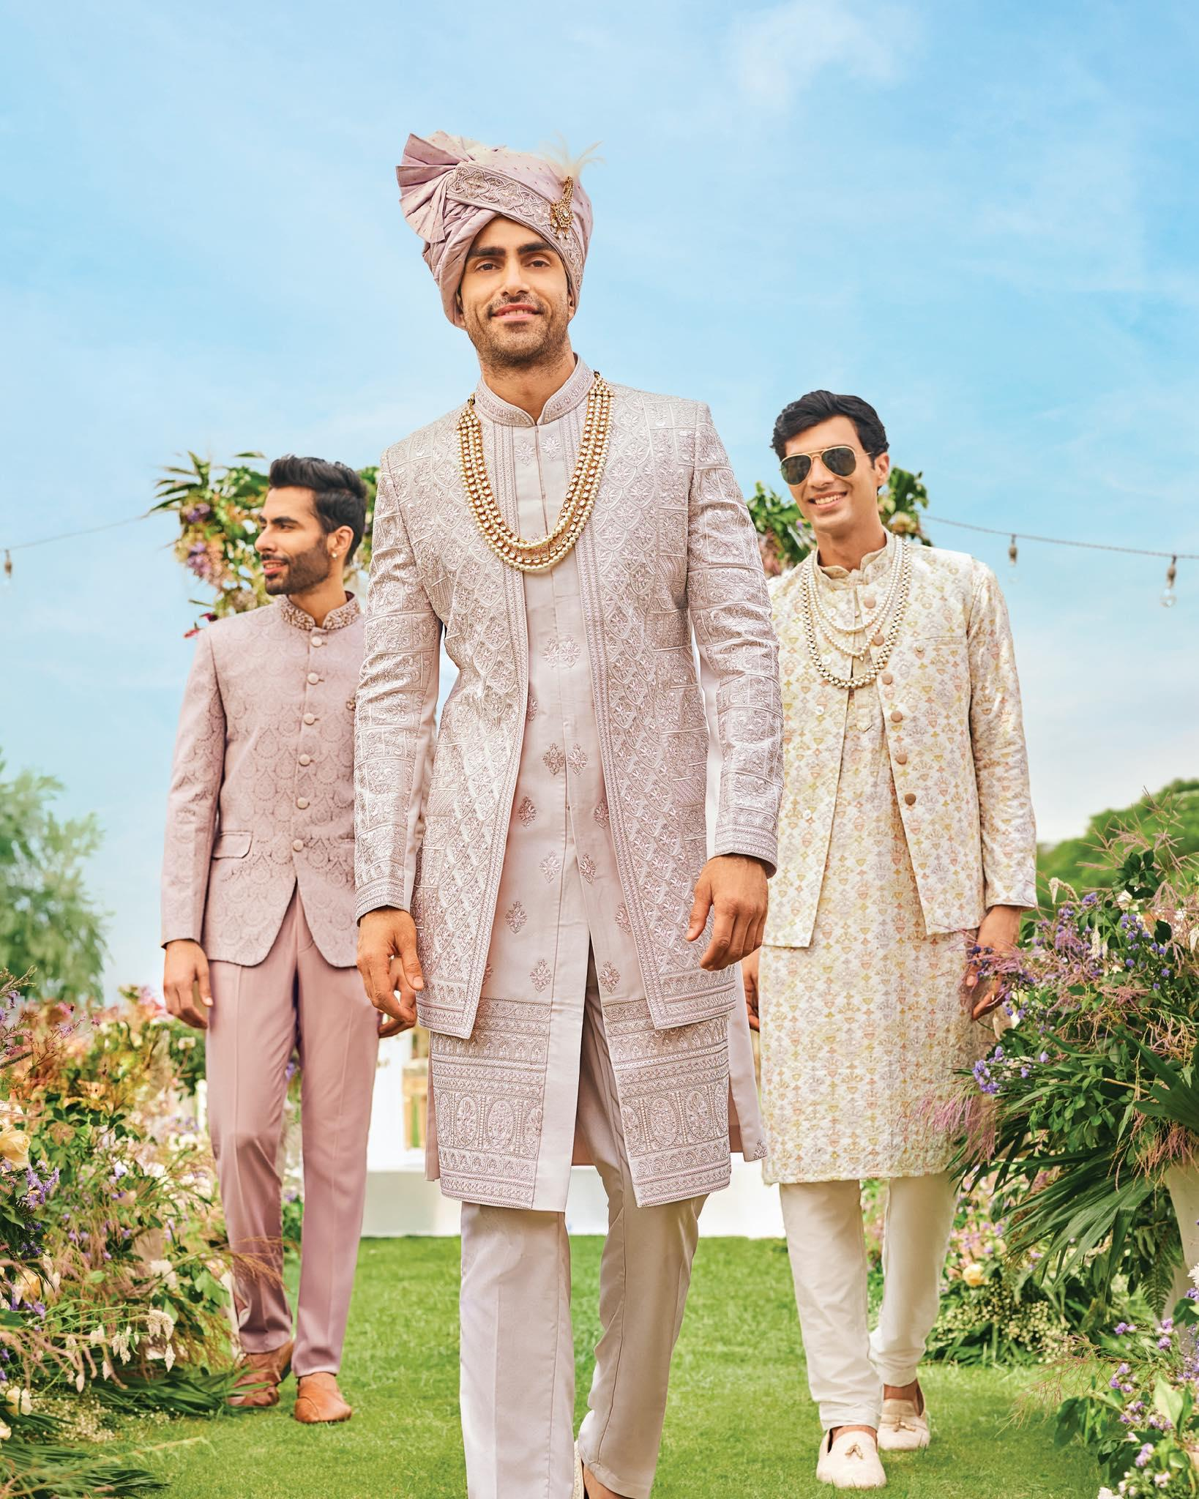
Fashioning Masculinity in Male Spaces
Participant observation (Boyce 2007; Dasgupta 2017)
Visual analysis of Indian cinema (Gopinath 2005, 2018)
The “new man” figure in commercial fashion ads (Nixon 1996)
Photo: The groom and his attendants are adorned in the serene splendor of the Aranya Collection, featuring textured fabrics, nature-inspired motifs, and intricate embroidery that embody timeless elegance (Manyavar Company, 2025).

Slide 8
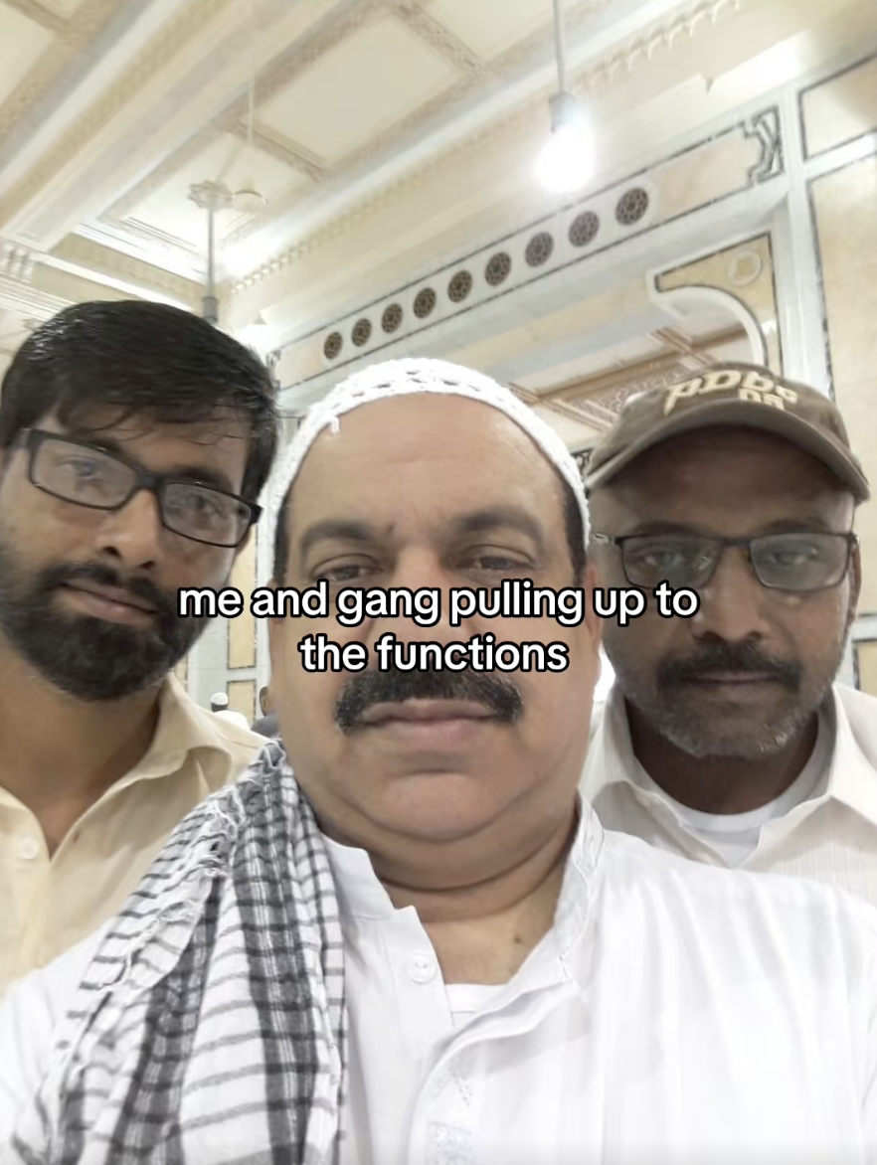
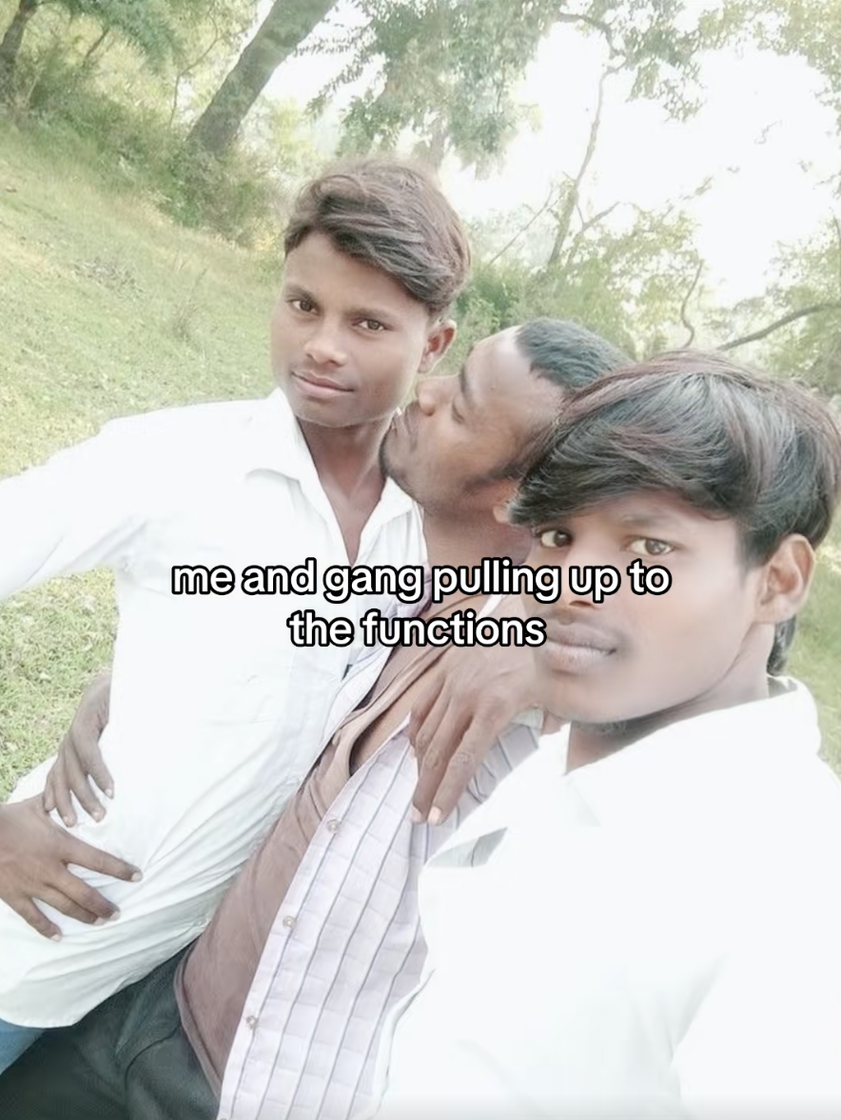
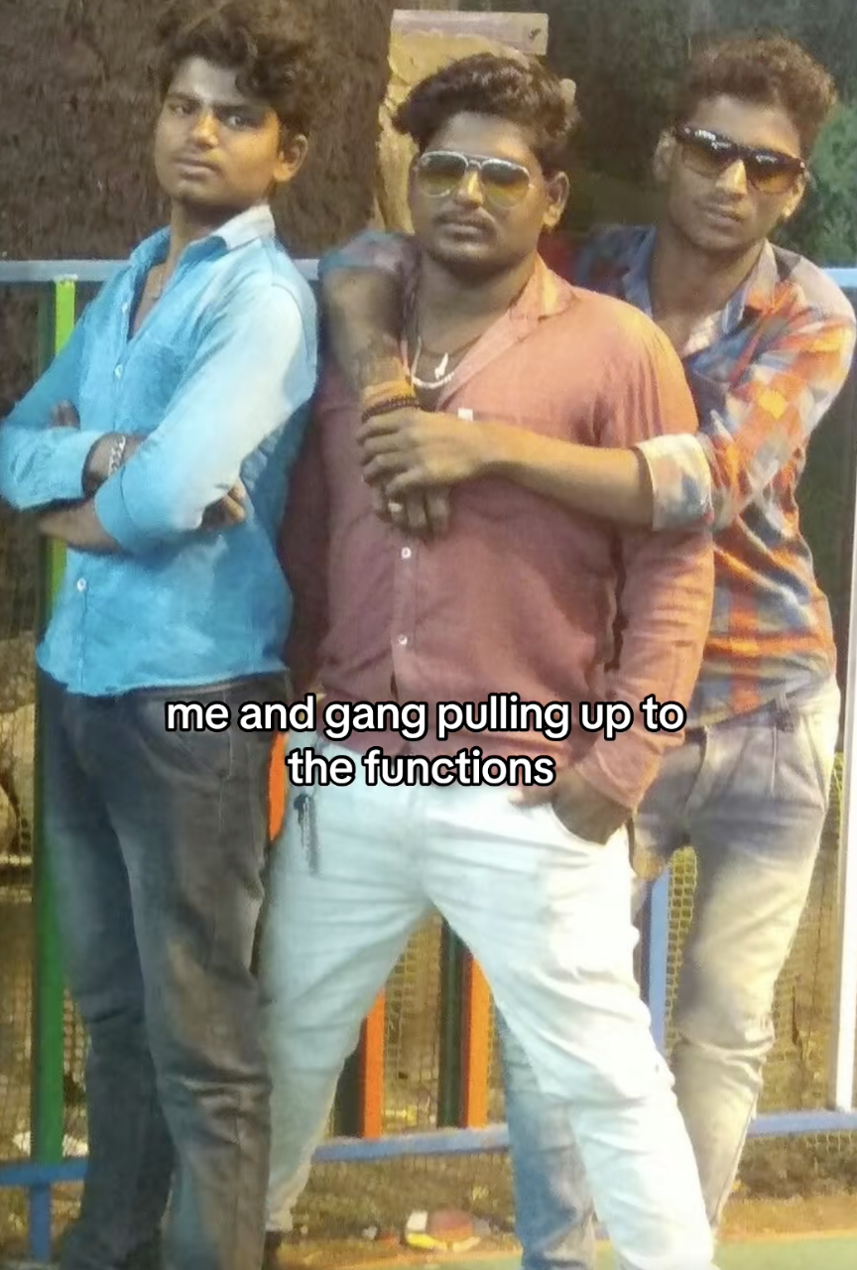
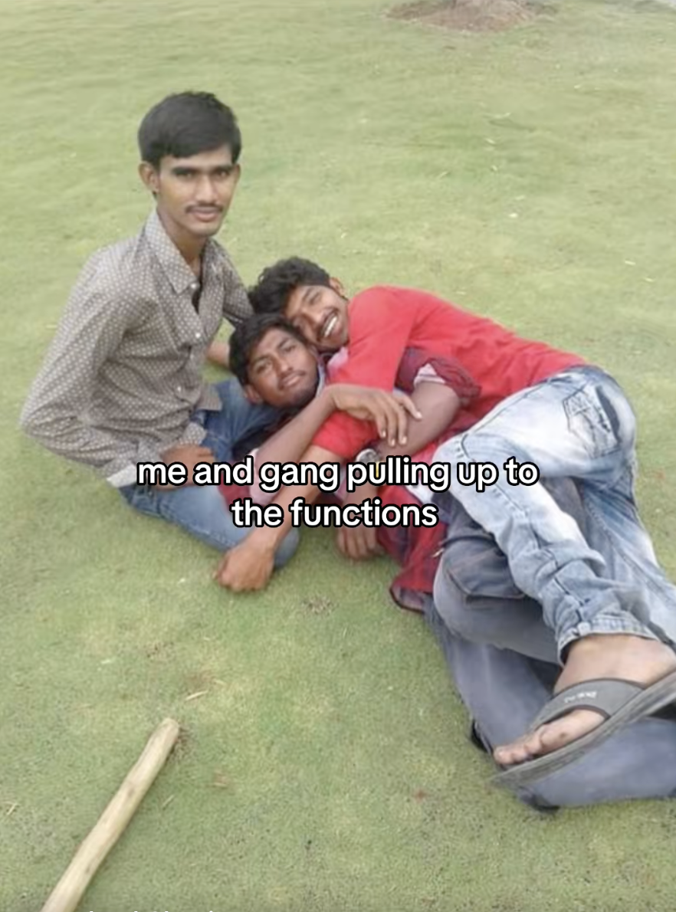
Organized Nonuniformity
It reflects stylistic variations within a shared collective image.
It is tied to specific socioeconomic affiliations.
It asserts a hierarchical position within the group.
It fosters a sense of belonging and homosocial desire.
Photo: This TikTok meme presents male bonding as a tight group with a clear hierarchy, in which the central figure appears as the leader, and humor comes from treating a group as a staged show of belonging through organized nonuniformity (2023–2024).
“My group’s leaders are confident, come from ‘good’ families, and dress stylishly. They always look hot.” (Mukesh 31, Navi Mumbai)

Slide 9
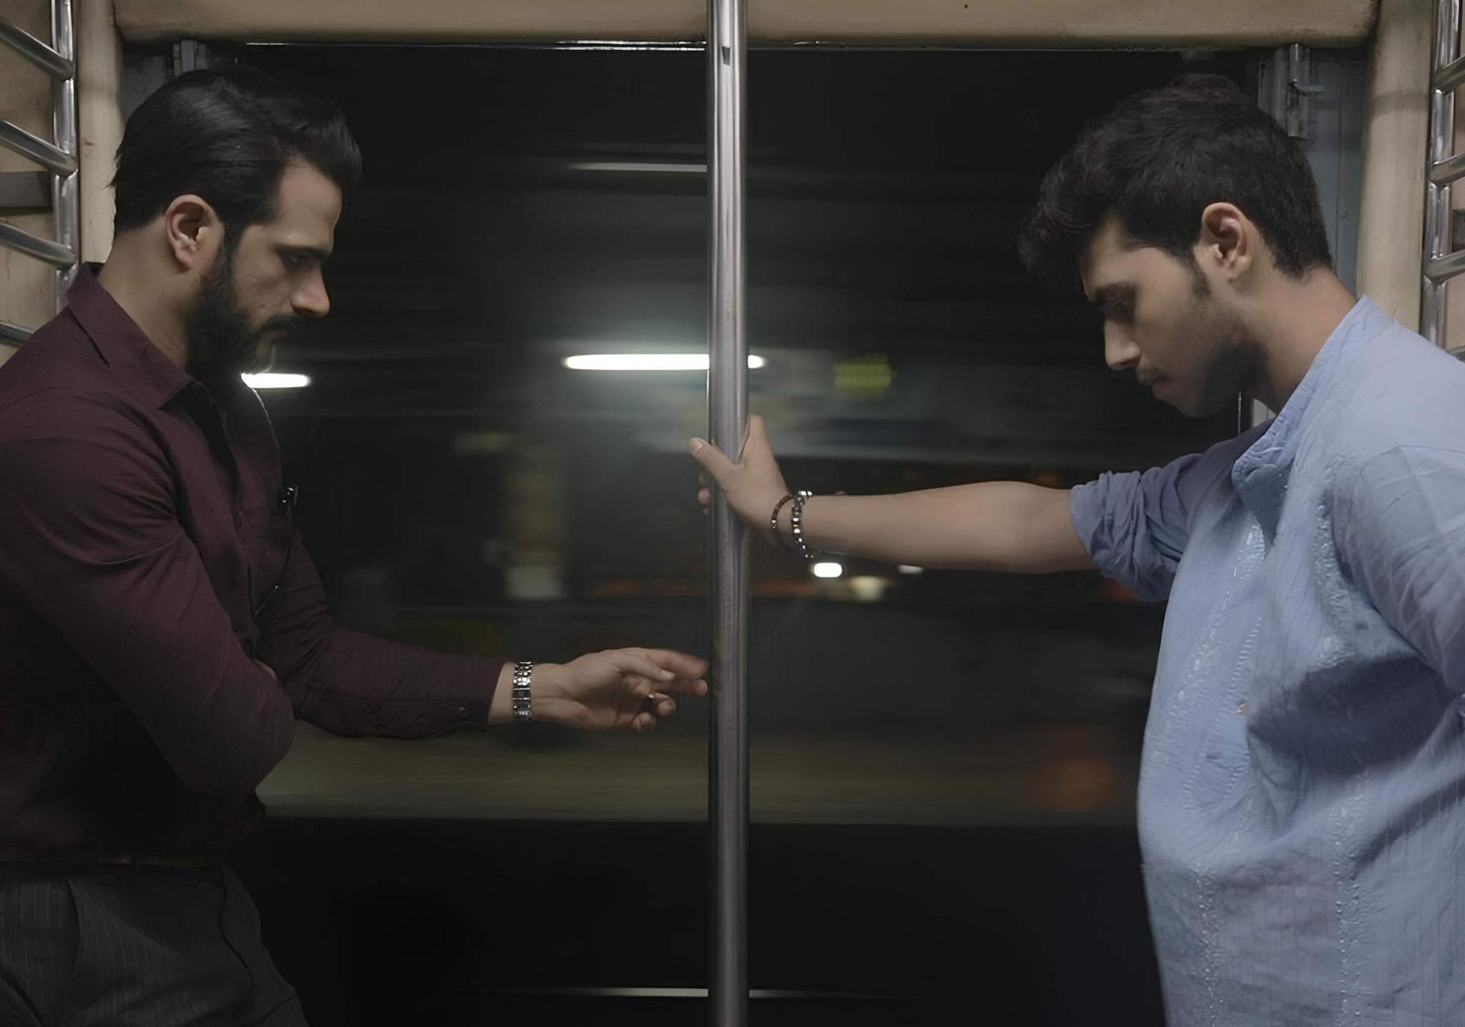
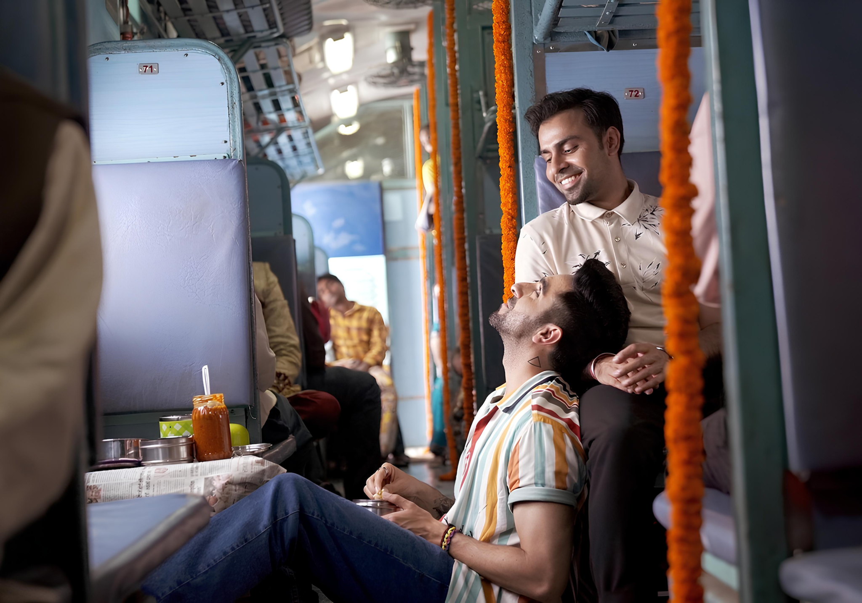
Homo(sociality) vs. Homo(sexuality)
Photo: A scene from the film Sisak 2017, dir. Faraz Arif Ansari.
Photo: A scene from the film Shubh Mangal Zyaada Saavdhan 2020, dir. Hitesh Kewalya.

Slide 10
Conclusions
Male self-fashioning is embedded within wider cultural scripts, systems of power, relationships, and shifting identities that simultaneously reconfigure the conventions of Indian masculinity.
“Organized nonuniformity” functions as an implicit form of visual communication, encoding group dynamics while affording men limited yet significant agency within a homosocial environment.
Men who engage in homosocial desire can transcend the stereotypes and nationalist ideals of Indianness by embracing social fluidity.

