Slide 1

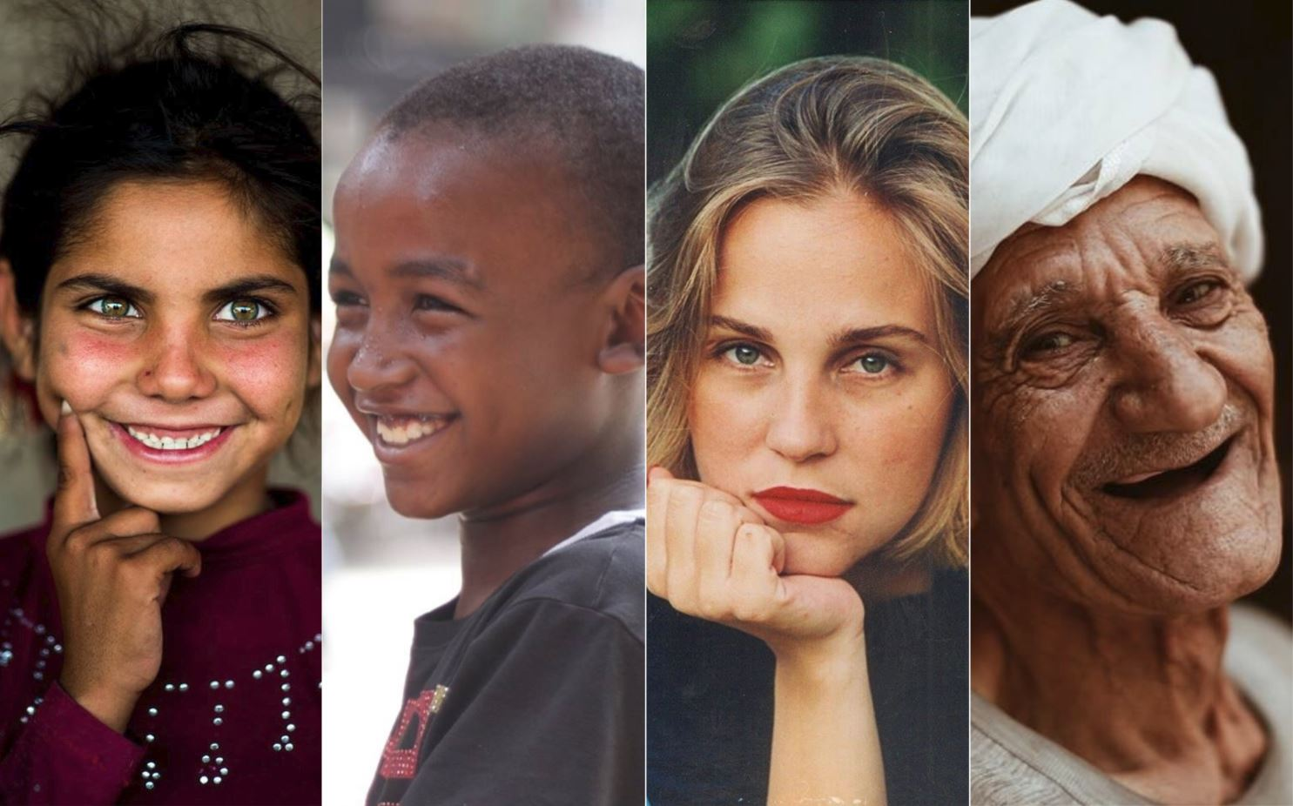
Diversity and Social Identity Leadership in the Al-Amara Tribe (Egypt)
Marina Apaydin, MsEE, MBA, MA, PhD
Associate Professor of Management
Onsi Sawiris School of Business
The American University in Cairo

Slide 2
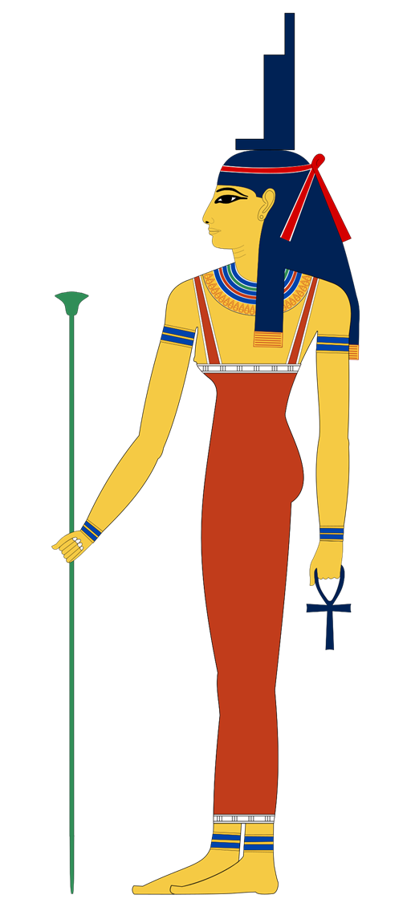
Agenda
Arab theories of leadership
Comparison with western leadership theories
Social identity leadership theory
AUC tribal leadership project at El Amara tribes, Upper Egypt
Diversity in Egypt
Uniting around common values

Slide 3
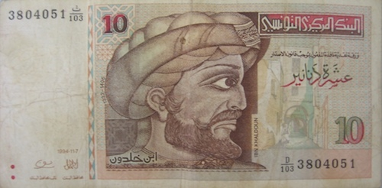
Ibn Khaldun (Sidani, 2008)
Ibn Khaldun (1332-1406) lived in North Africa and is considered to be the “father of sociology” for his work Muqadimmah
Human nature consists of emotional animal self responsible for evil and conscious human self (Kahneman) seeking virtuous life (Aristotle)
Unlike animals, humans have perceptual IQ and experimentational IQ which are developed through education (3A)
Humans need authority to restrain animal behaviour of less educated people as “man seeks his bare necessities first” (Maslow)

Slide 4
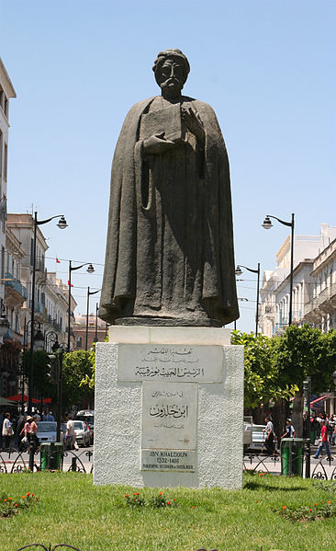
Ibn Khaldun’s view on Leadership
Leaders cant emerge without Asabiah (group feeling)
Asabiah is based first on blood ties (in Bedouin society) and common interests (modern society)
“Man is a natural leader and every Bedouin is eager to be a leader”
Leadership is based on Asabiah and religion
Leaders should lead “kindly” through love, consent and respect
They need to develop in themselves “perfecting details” (p. 79)
“Followers imitate the leader as students imitate the teacher”
Asabiah compensate for the lack of social development
Royalties have power vested in position, not in character and thus need coercive tools for obedience

Slide 6
Ibn Khaldun vs modern leadership theories
MODERN
Leader personality traits:
self-esteem need for power
impression management behaviors
other functional behaviors
Followers’ personality traits:
self-identity
self-esteem
Follower attributions
Environmental/contextual
High internal cohesion
High performance potential
organizational effectiveness
satisfaction with leadership
IBN KHALDUN
Descent/religion eagerness to
leadership perfecting qualities
consideration for followers
persuasion techniques
Descent/religion follower social development
degree of leader acceptance
degree of interaction with leader
Asabiah
Initial obedience/compliance follower
imitation of leader intensification of authority
organizational order/stability
LEADER
FOLLOWERS
OTHER FACTORS
OUTCOMES

Slide 7
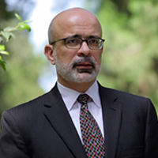
Yusuf Sidani concludes:
Western theories are made for individualistic societies focused on task performance where leadership is vested in position
Arab leadership is vested in the character and Asabiah (group feeling) and is suitable for collectivist societies without strong institutions who are seeking harmony

Slide 8
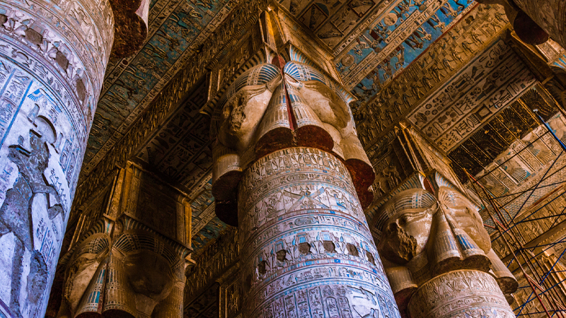
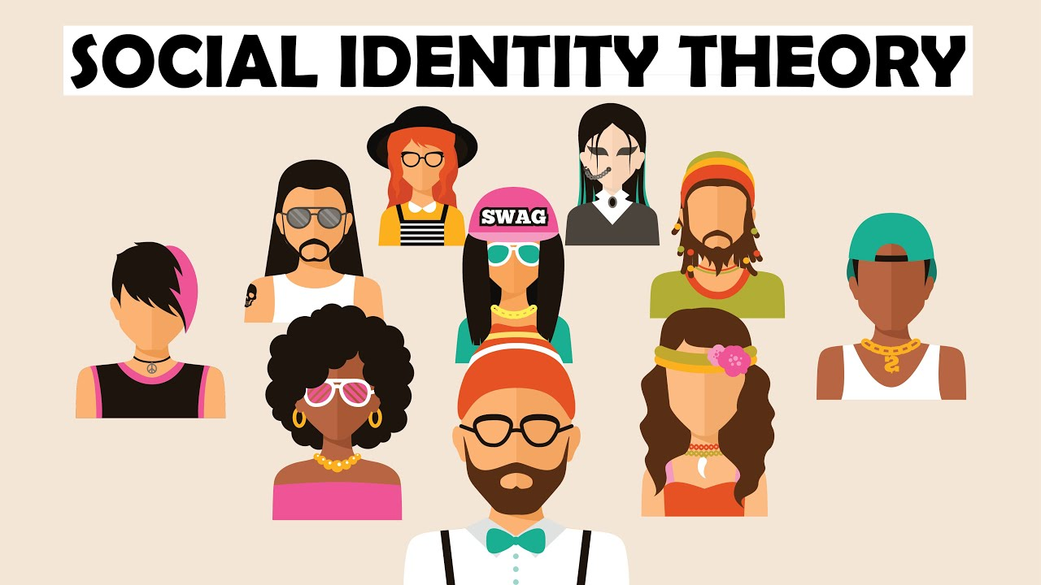
Social Identity Leadership theory (Tajfel, 1978):
Leadership is a collective journey, not an individual destination

Slide 9
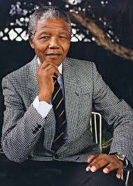
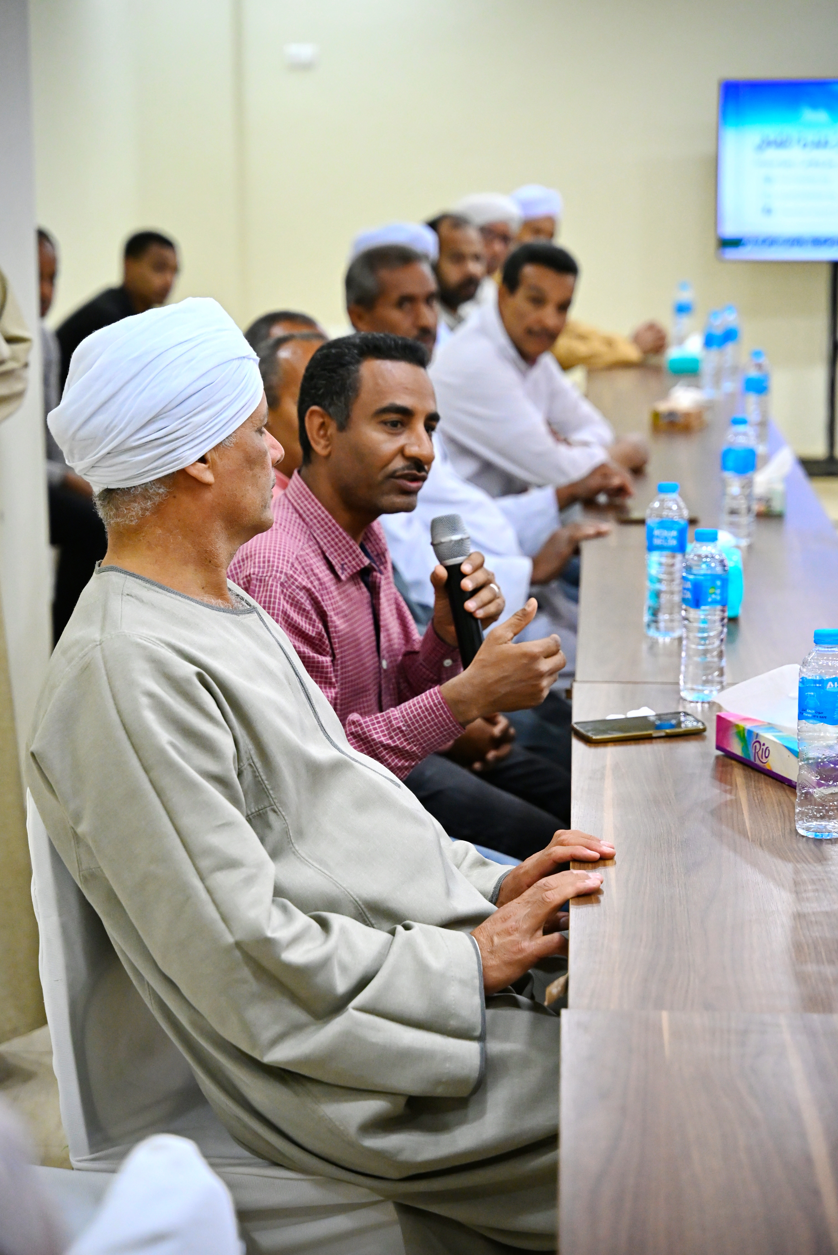

Beyond the "Great Man" Theory of Leadership
Leadership is a relationship, not a property of one person's DNA
The Old Narrative
The New Truth
Leadership was a "magic gift" belonging to a few "Great Men." We were told you must have a special personality or be born with power
True leadership is not about the individual; it is about the group. It is a relationship between leaders and their people

Slide 10

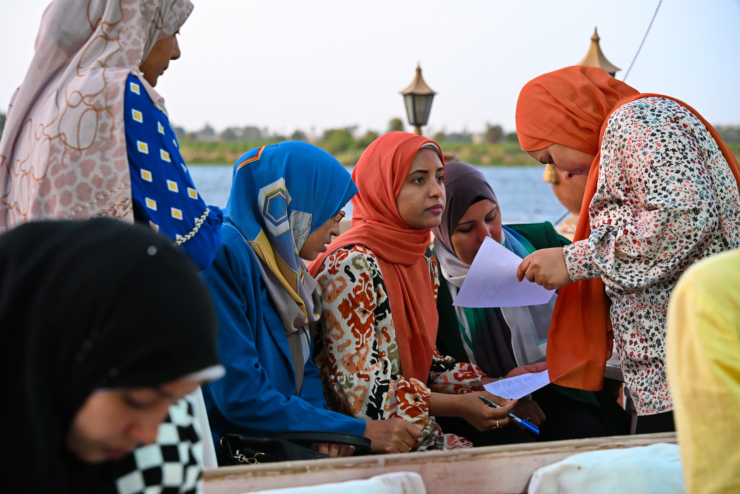
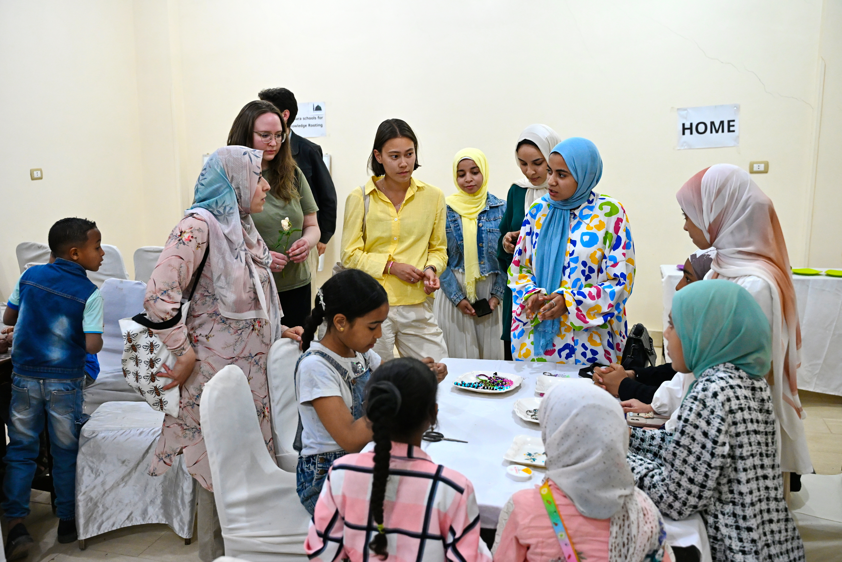
Leadership is Not "Men's Business“
Women inclusion as a source of strength

Slide 11
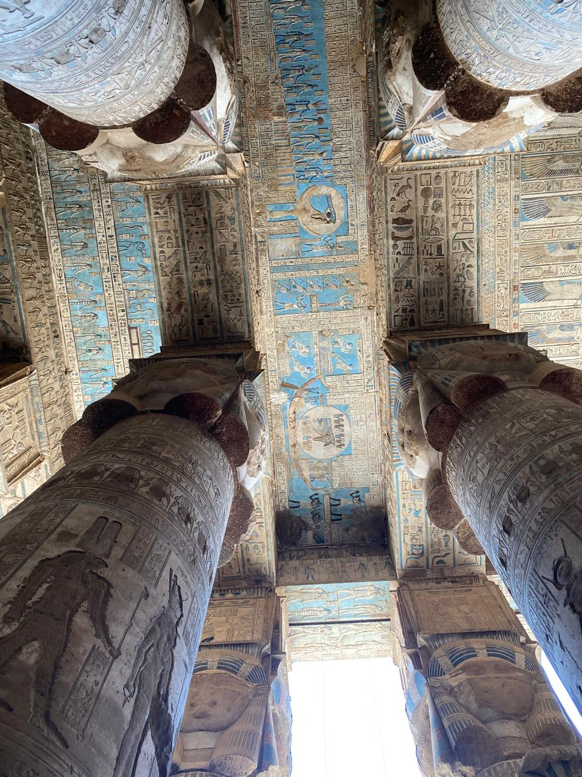




The Four Vital Pillars of Leadership
(Steffens, Haslam et al., 2014)
Being "One and Best of Us"
Be a model member of the group, share our values and our life
“Doing It For Us”
Be a champion for the group, prioritize the tribe’s welfare over their own
“Crafting a Sense of Us”
Help the community understand its history and future
“Making Us Matter”
Turn group goals into reality by proactive implementation

Slide 12

TRIBAL LEADERSHIP PROJECT
El Amara Tribes – Egypt

Slide 13
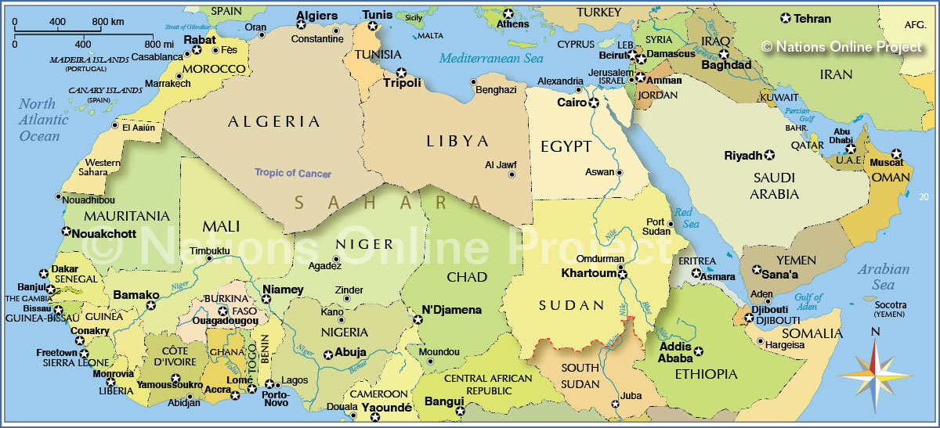
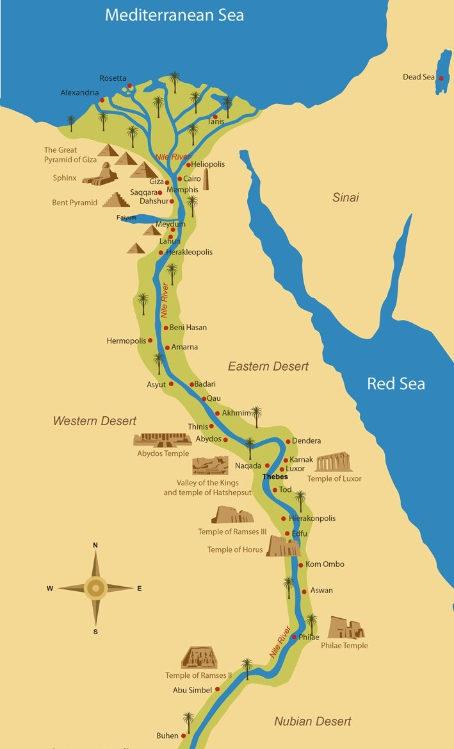
EL AMARA tribe - context
In early 19th century Sultan Yusef, descendant of Idriss I & II of Maghreb (border of Morocco and Algeria) travelled to Mecca for Hajj and stopped in Dandera on the Nile river
He liked the location so much that he remained there and founded El Amara tribe
Tribe’s leader became known as El Dandrawy
Today El Amara tribe has about 100,000 members organized in larger “families” and smaller “houses”
Tribe/s main location remains upper Egypt with some members living in the north of Egypt and abroad
The tribe is “governed but not controlled” by the Egyptian government

Slide 14
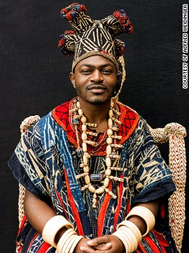
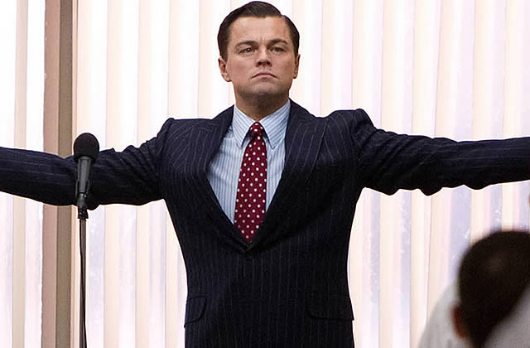
Egyptian tribal leader
Expectation Reality

Slide 15

Tribal leader – Amir Hesham El Dandrawy
Finished French school in Cairo
Graduated from AUC BBA – 1988
Studied in Sorbonne, Paris
Spent 6 years in Tanzania trading Asian rice
Established Team4 security company in 1999
Established East Wind company for dogs training
Operating in Egypt, Czech Republic and the Netherlands
Returned to Egypt to lead his tribe in 2010
Watch: https://www.youtube.com/watch?v=Le9UjkaVaRw

Slide 16
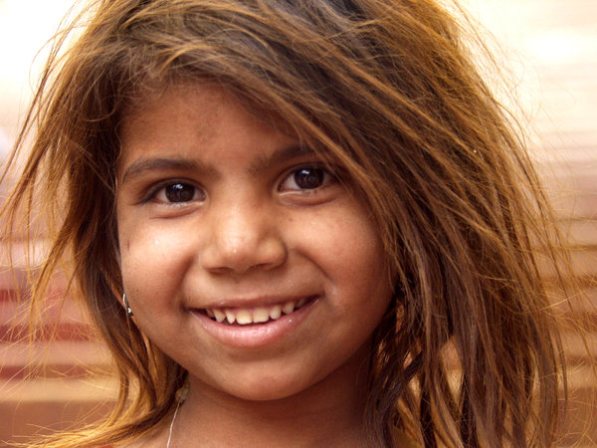
Amir’s guiding principles
Established by Fadl El Dandrawy, Hashem’s father
Grounded in Islamic philosophy and ethics
Mission: development of human beings socially, economically and intellectually
Hashem’s mission: translate thoughts (family knowledge) into words and actions to build a cohesive and inclusive world, grounded in ethical character and behavior
Reject the importance of material things for spiritual growth
Success is measured by happiness of his people

Slide 17
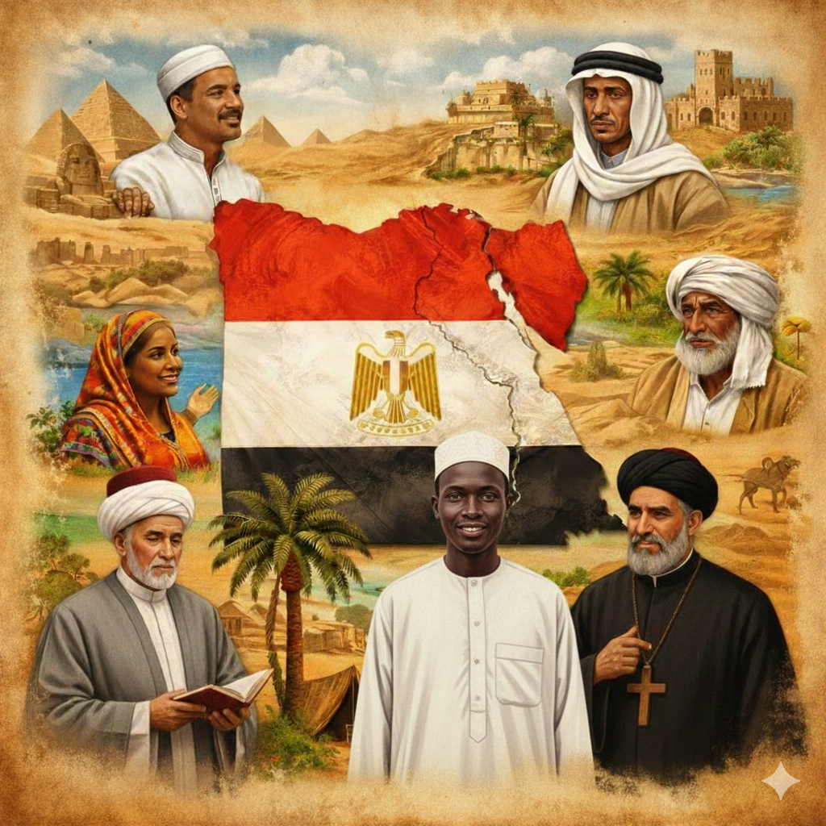
Diversity in Egypt
Nubians – Indigenous to southern Egypt
Berbers (Amazigh) – Mostly found in the Siwa Oasis (West)
Bedouins – Traditionally nomadic Arab tribes, Sinai and the Western Desert
Greeks, Armenians, and Levantine Arabs – particularly in Alexandria and Cairo
Foreign Expats – people from Africa, Europe, Asia, and the Americas, particularly in Cairo and coastal cities

Slide 18
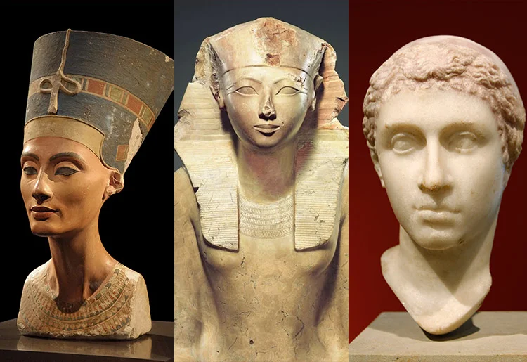
Ancient Egyptian Female Leaders
Nefertiti Hatshepsut Cleopatra

Slide 19


Tribal values are a combination of Pharaonic and Islamic values
Honesty
Kindness (to people and animals)
Charity
Justice
Respecting parents and elders
Keeping promises
Moderation
Religiosity
Isis – the Pharaonic Goddess

Slide 20
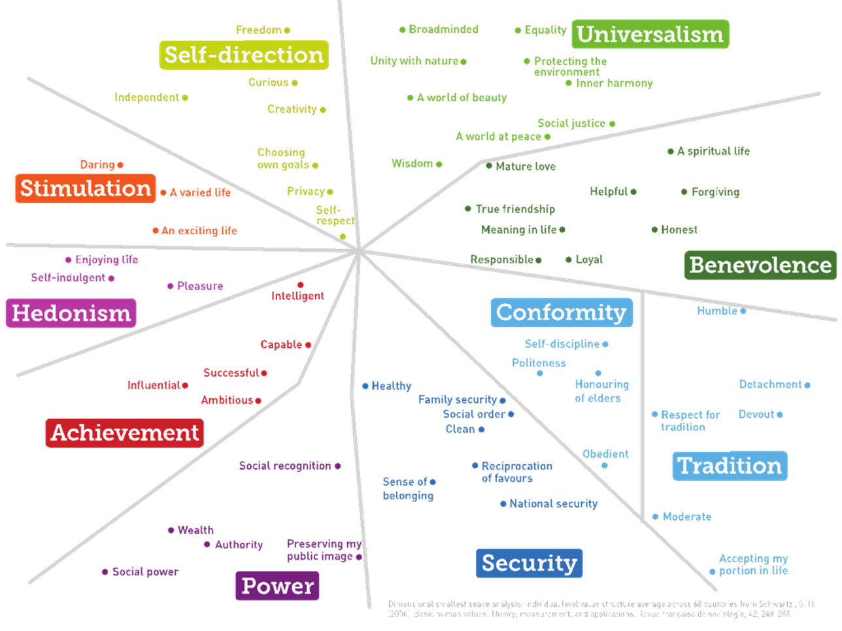

Schwartz Values Map
https://www.youtube.com/watch?v=kxTkKgPpLO8

Slide 21
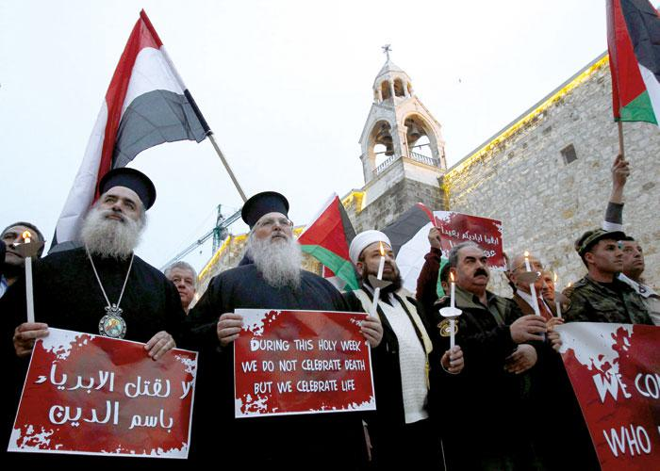
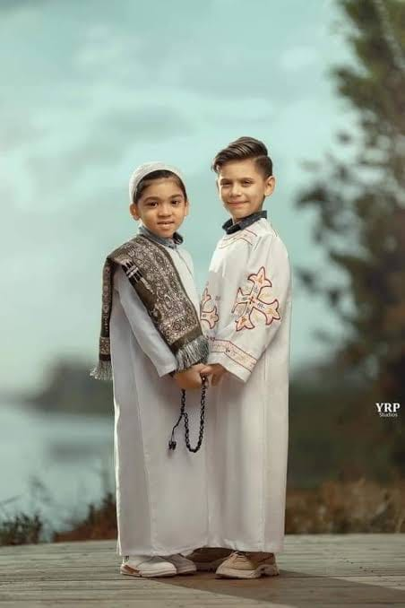
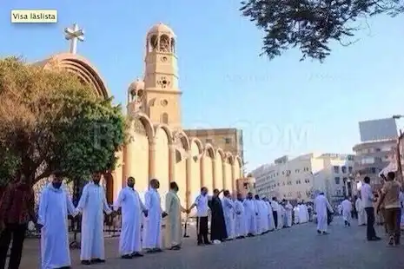
Uniting around common values
Muslims defending Catholic church in Egypt during riots in 2013
Standing together against violence in 2017

Slide 22
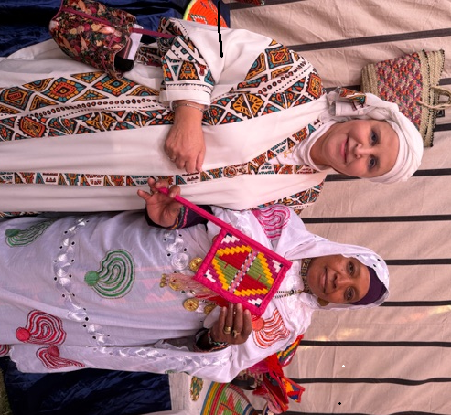
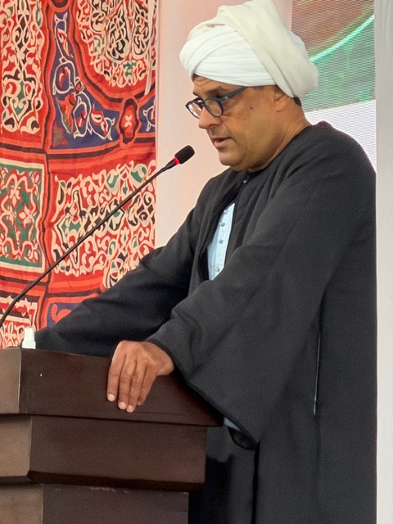
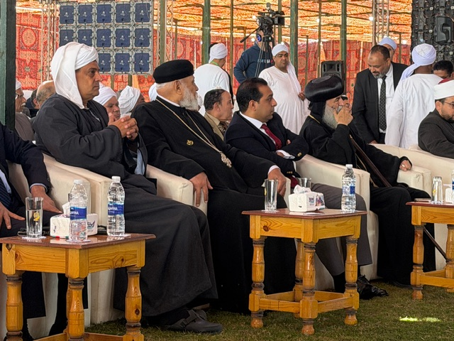
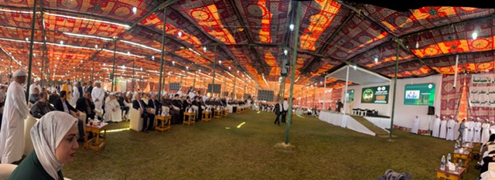
2026 Cultural Conference in Dandara

Slide 23
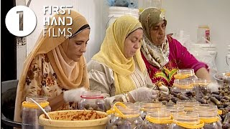
AUC Leadership Project
2023-26
Parallel Schools established on the 4 pillars of Dandara Temple: science, communication, innovation, ethics,+ accepting differences
Women empowerment through a startup
Hashem’s leadership profile and style
  Followers’ sentiments
  Dark side of leadership (dealing with problems)
Tribe’s organization and governance
Conflict resolution

Slide 24
Conclusion
Developed in individualistic societies, western leadership theories were focused mostly on individual qualities and personality traits of the leaders
Laymen view posited that leaders are born and not made
Arab patriarchal society built their leadership theories on the expectations of a “Great Man”
In Egypt, a combination of the ancient Pharaonic traditions and local value system created an inclusive, value-based view of leadership
Social identity leadership theory grounded in the followers’ perspective is more appropriate then the earlier leader identity theories
In a society guided by common values, diversity can be respected and appreciated as the example of Al-Amara tribes illustrates

Slide 25
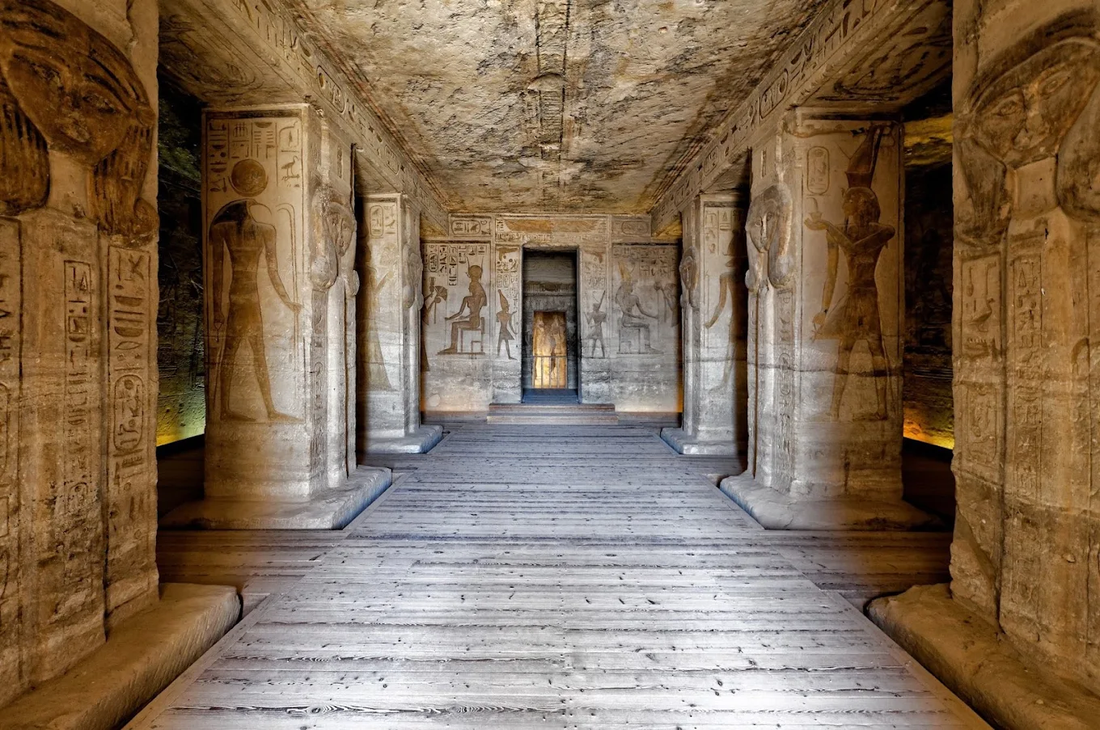
Thank You

