Slide 1
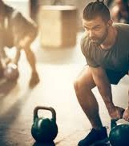
Nutritional
Supplements
The Role of Nutritional Supplements in Enhancing Performance and Recovery in Individual-Sport Athletes
Authors:
Msc. Narvina Sinani1, Prof.Asc.Dr.Najada Quka2,
Director of Business Development, Evita Pharmaceutical and Medicine Company, Albania
Sports University of Tirana, Albania Email: narvina.sinani@yahoo.com

Slide 2
Introduction
Background and Prevalence of Supplements
Nutritional Importance
Nutritional supplements play a critical role in enhancing athletic performance, providing essential nutrients that may be lacking in an athlete's diet and aiding in optimal recovery post-exercise (Thomas, Erdman & Burke, 2016; Maughan et al., 2018).
Supplement Usage
The prevalence of supplement use among individual- sport athletes has surged, with recent surveys indicating that over 70% of athletes regularly incorporate supplements to improve performance and support recovery efforts (Knapik et al., 2016; Maughan et al., 2018).

Slide 3
Physiological Role of Supplements
D i e t a r y s u p p l ements may i nf l u e n c e p e r fo rmance t h r o u g h s e v e r a l p h y s i o l o g i c a l mechanisms:
i mprovement o f e n e r g y metabolism
  i n c r e a s e d n e u r omuscular e f f i c i e n c y
  e nhanced muscle p r o te i n s ynthesis
  r e duct i o n o f i nf l ammation a n d o x i d at i v e s t r e s s
These mechanisms c a n c o l l e c t i v e l y c o nt r i b ute t o i mproved t r a i n i n g a d a ptat i o n a n d r e c o v e r y c a p a c i t y i n ath l e te s ( Kre i de r e t a l . , 20 1 7 ) .

Slide 4
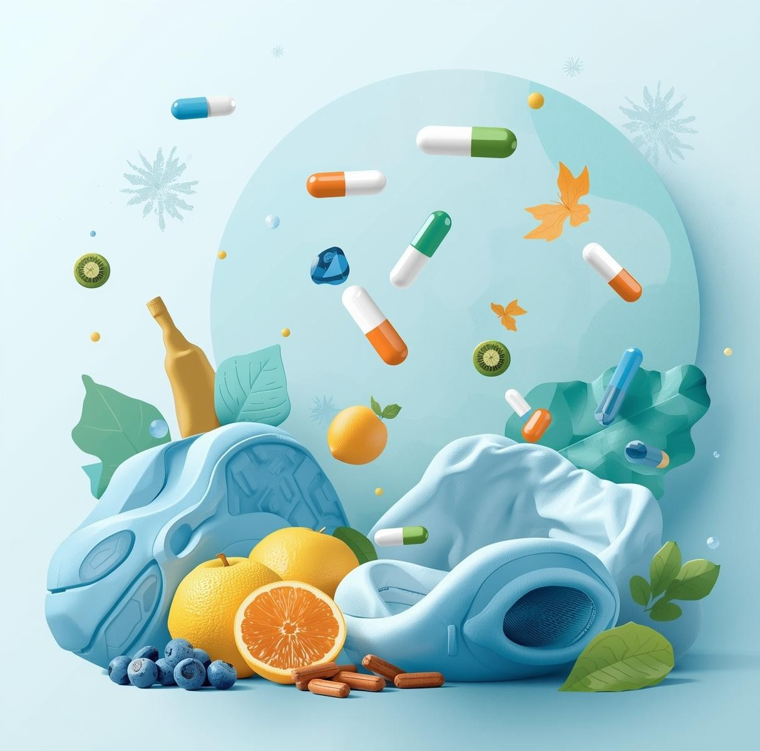
Aim of the Study
The aim was to provide and analyze the scientific evidence regarding the effects of nutritional supplements on:
athletic performance
  recovery processes
  physiological adaptation in individual-sport athletes Additionally, the study seeks to present the research findings into practical recommendations for athletes and coaches.

Slide 5
Methodology
Systematic Search and Data Extraction
Search Strategy
A systematic search was conducted across PubMed, Scopus, and SportDiscus databases. Inclusion criteria focused on studies involving nutritional supplements and individual-sport athletes, ensuring comprehensive data extraction and analysis.

Slide 6
Most Common Supplements Used in Sports Nutrition
and Level of Scientific Evidence
Supplement
Creatine
Protein (Whey / EAA)
Caffeine
Beta-alanine
Omega-3 fatty acids
BCAAs
Evidence
Level
Very Strong
Very Strong
Strong
Strong
Moderate
Moderate
Main Scientific Evidence
Increases intramuscular phosphocreatine stores, enhancing strength, power, and repeated sprint performance
Stimulates muscle protein synthesis, promotes recovery and hypertrophy after resistance exercise
CNS stimulant; improves endurance, reaction time, and reduces perceived exertion
Increases intramuscular carnosine; enhances buffering capacity, delaying fatigue in high- intensity exercise
Anti-inflammatory effects; supports recovery and reduces exercise-induced muscle soreness
May support muscle recovery and reduce exercise-induced muscle damage, though less consistent than whole protein
Key References
Kreider et al., 2017; Maughan et al., 2018
Morton et al., 2018; Maughan et al., 2018
Grgic et al., 2019; Peeling et al., 2018
Saunders et al., 2016
Thielecke & Blannin, 2020
Maughan et al., 2018

Slide 7
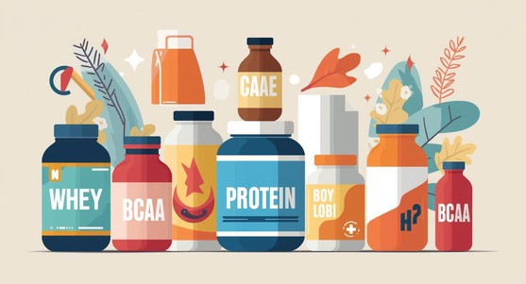
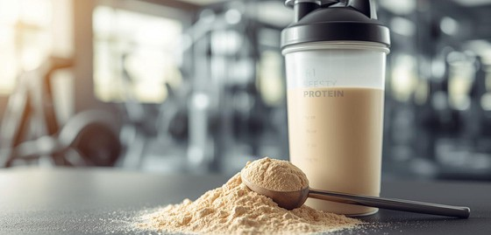

Key Findings on Nutritional Supplements
Protein
Protein supplementation also plays a key role
in exercise adaptation by stimulating muscle protein synthesis and supporting recovery following resistance training (Morton et al., 2018).
Creatine
Creatine monohydrate has been extensively investigated and demonstrates consistent benefits for:
maximal strength
  repeated high-intensity efforts
  lean muscle mass development
These effects are largely explained by increased phosphocreatine availability and improved ATP resynthesis during intense muscular contractions (Kreider et al., 2017).
BCAAs
BCAAs is frequently associated with fatigue reduction.
BCAAs may contribute to reduced muscle damage and improved recovery, although evidence indicates that their effects are generally smaller compared with complete protein intake (Plotkin et al., 2021).

Slide 8
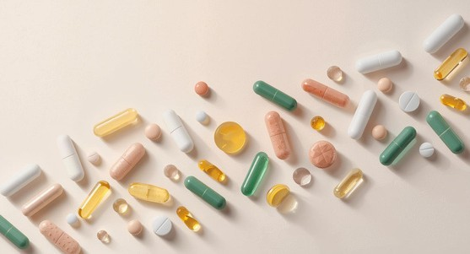
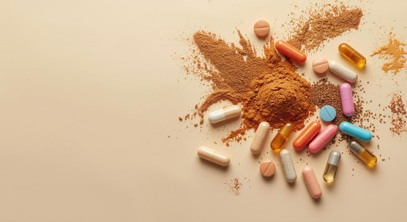
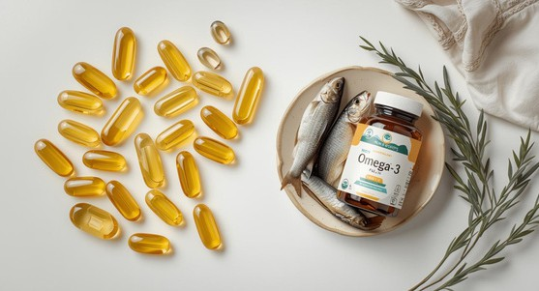
Beta-Alanine
Nutritional
Supplement
Beta-alanine is frequently associated with fatigue reduction. It increases intramuscular carnosine concentrations, improving buffering capacity during high-intensity exercise lasting one to several minutes (Saunders et al., 2017).
Benefits for
Athletes
Caffeine
Caffeine is one of the most widely studied ergogenic substances in sports science. Acute ingestion prior to exercise has been shown to:
improve endurance performance
  increase alertness and reaction time
  reduce perceived exertion during exercise
These effects are primarily mediated through central nervous system stimulation and enhanced motor unit recruitment (Grgic et al., 2019).
Omega-3s
Supports joint health and reduces inflammation post-exercise (Smith et al., 2011)

Slide 9

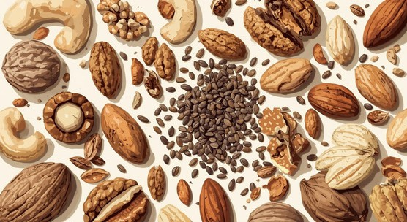
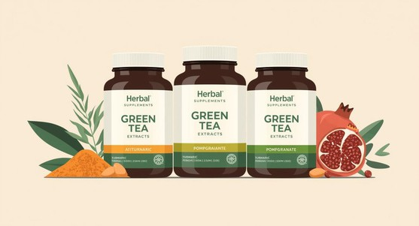
Summary of Antioxidants and Their Benefits
Antioxidant Sources
Fruits and vegetables are rich in antioxidants beneficial.
Health Benefits
Antioxidants support recovery and combat oxidative stress.
Supplement Options
Various supplements can enhance antioxidant intake effectively.

Slide 10
Typical Dosage of Key Supplements, and Physiological Effects
Supplement
Creatine Monohydrate
Protein (Whey/EAA)
Caffeine
Beta-alanine
Omega-3 fatty acids
Typical Dose
3–5 g/day
20–40 g post- exercise
3–6 mg/kg
4–6 g/day
1–2 g/day
Main Physiological Effect
Increases phosphocreatine stores in skeletal muscle
Stimulates muscle protein synthesis
Central nervous system stimulation and reduced perception of fatigue
Increases muscle carnosine concentration
Anti-inflammatory and cell membrane stabilization effects
Performance Outcome
Improves strength and power output
Enhances recovery and muscle hypertrophy
Improves endurance and reaction time
Delays fatigue during high-intensity exercise
Supports recovery and reduces muscle soreness
Reference
Kreider et al., 2017
Morton et al., 2018
Grgic et al., 2019 Saunders et al., 2016 Thielecke & Blannin, 2020
Training Phases and the recommended Practical Supplementation Protocol
Training Phase
Pre-training
Training cycle Post-exercise
High-intensity training blocks
Recovery periods
Supplement Strategy
Caffeine
Creatine
Protein / amino acids Beta-alanine
Omega-3 fatty acids
Expected Benefit
Increased alertness and improved exercise performance
Strength and power adaptations
Muscle recovery and repair Increased fatigue resistance
Reduced inflammation and improved recovery
Reference
Grgic et al., 2019
Kreider et al., 2017 Morton et al., 2018
Saunders et al., 2016 Thielecke & Blannin, 2020

Slide 11
Conclusions
Implications and future research directions
Practical Implications
Nutritional supplements can significantly enhance athletic performance and recovery, but individual responses vary. Further research is needed to establish optimal dosages and long-term effects on health.

Slide 12
Questions?

