Slide 1


ICMS 47, Brussels 2026
Beyond Integration:
A Framework for Inclusive Higher Education and Social Participation of People with Disabilities
Valentina Chkoniya
Polytechnic University of Coimbra, ISCAC, Coimbra, Portugal.

Slide 2
According to EU data.
The European Disability Forum (EDF) and Inclusion Europe emphasise that education is a fundamental human right and a cornerstone of full participation in society, including access to the labour market
EARLY SCHOOL LEAVING
among persons with disabilities
reaches 20.3%, compared to 10.8% among persons without disabilities.
EDUCATION AT TERTIARY LEVEL
only 30.9% of persons with disabilities continue their education at tertiary level . Compared to ~43–45% of non-disabled people
Beyond Integration: A Framework for Inclusive Higher Education and Social Participation of People with Disabilities
LABOUR MARKET
Only about 50–51% of persons with disabilities are employed. Compared to ~75–76% of non-disabled people.
Despite international legal frameworks, including Article 24 of the United Nations Convention on the Rights of Persons with Disabilities (UNCRPD), the rate of early school leaving among persons with disabilities remains significantly higher than among the non-disabled population.
THE GAP IS NOT IN POLICY BUT IN IMPLEMENTATION.

Slide 3
An analysis of education systems across Europe indicates that current strategies often focus primarily on integrating persons with disabilities into mainstream educational institutions without ensuring genuine inclusion.
In practice, architectural, legal, psychological and social barriers persist, limiting access to education and full participation in social life.
Beyond Integration: A Framework for Inclusive Higher Education and Social Participation of People with Disabilities
As a result, persons with disabilities are at higher risk of social exclusion, restricted employment opportunities and marginalisation

Slide 4
What evidence shows?
Being enrolled does not equal being included..
Over 50%
Less than 40%
Beyond Access: The Limits of Integration
of students with disabilities report barriers in accessing buildings, materials, or services
receive adequate accommodations
Beyond Integration: A Framework for Inclusive Higher Education and Social Participation of People with Disabilities
Common barriers:
Physical inaccessibility
Lack of trained staff
Stigma and low expectations
Exclusion in education becomes exclusion in economic and social life.
Poverty risk
People with disabilities are at significantly higher risk of poverty and social exclusion (~28% vs ~18%)

Slide 5
A Systemic Approach
Rethinking Inclusion
Research across EU higher education systems shows that Inclusion policies are often:
Shift required:
Fragmented.
From individual accommodation to system-wide transformation
Beyond Integration: A Framework for Inclusive Higher Education and Social Participation of People with Disabilities
Underfunded
Poorly monitored

Slide 6
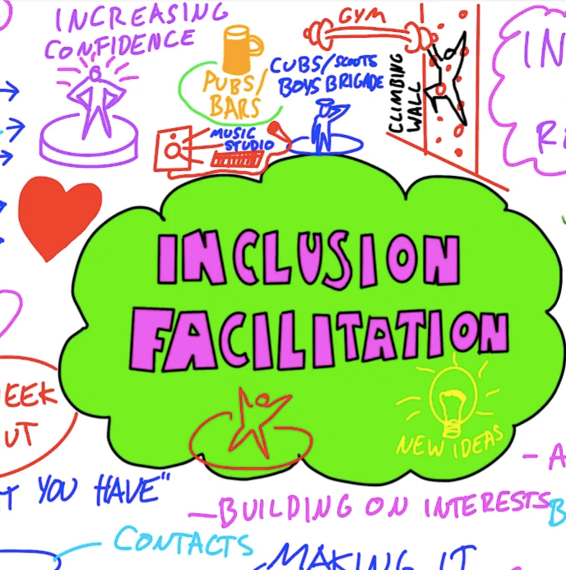
Proposed Solution
A New Professional Profile
Beyond Integration: A Framework for Inclusive Higher Education and Social Participation of People with Disabilities
Studies indicate that Institutions with dedicated inclusion professionals show:
A Facilitator of Inclusive Practices.
Higher student retention
Better accessibility outcomes
Increased satisfaction levels

Slide 7
A Facilitator of Inclusive Practices.
Core Competencies of the Role
Skills gaps identified in European universities:
Beyond Integration: A Framework for Inclusive Higher Education and Social Participation of People with Disabilities
Over 60% of academic staff
Below 50% in many institutions
report insufficient training in inclusive teaching
Digital accessibility compliance remains
Competencies needed:
Pedagogical
Social
Cultural
Digital

Slide 8
A Facilitator of Inclusive Practices.
Key Functions in Practice
Functions:
Barrier identification
Inclusive design
Student empowerment
Institutional coordination
87%
20%
Beyond Integration: A Framework for Inclusive Higher Education and Social Participation of People with Disabilities
25%
Student engagement significantly increases
Retention rates improve up to 20%
Impact of structured inclusion support:

Slide 9
A Facilitator of Inclusive Practices.
The Power of Interdisciplinarity
Cross-sector collaboration results:
Beyond Integration: A Framework for Inclusive Higher Education and Social Participation of People with Disabilities
Smoother transitions to employment
Higher participation in lifelong learning
Improved social inclusion indicators
Education
Training
Community
Labour market

Slide 10
A Facilitator of Inclusive Practices.
From Fragmentation to Collaboration
Current challenge:
Long-term funding
partnerships
Many inclusion initiatives remain project-based and temporary
Beyond Integration: A Framework for Inclusive Higher Education and Social Participation of People with Disabilities
Successful models show:
sustained impact
Long-term funding + partnerships = sustained impact

Slide 11

What matters? What is differently experienced?
Magic performance
Interconnectedness of the cognitive, affective and relational enactments of Creative Learning
Feelings of surprise, wonder, and curiosity –
optimism and experimentalism:
  to help lessen thinking fixation
  to encourage Critical Thinking and Possibility Thinking (What if?”)
  to activate a flexible mindset which invites alternative solutions
  to develop new solutions to generatively turn the impossible into the possible
To zdjęcie, autor: Nieznany autor, licencja: CC BY-SA

Slide 12
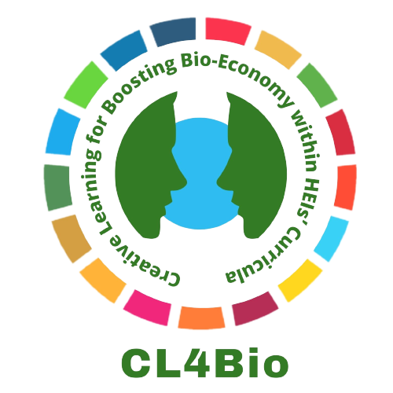



Creative Learning for Boosting Bio-economy within HEIs’ Curricula

Slide 13
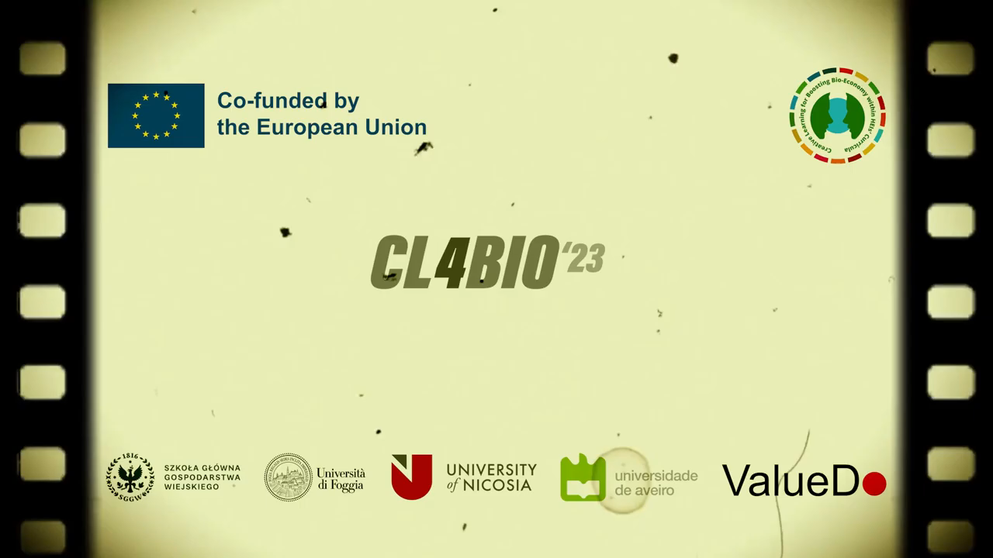

Slide 14
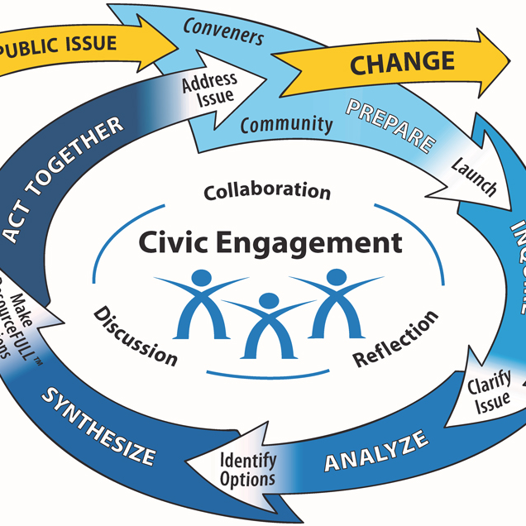
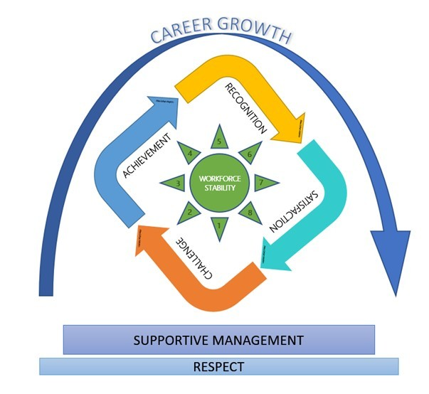
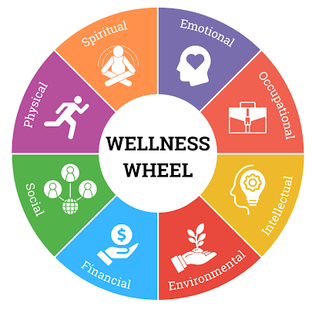
Inclusive education systems correlate with:
Inclusion as a Driver of Justice and Futures
Beyond Integration: A Framework for Inclusive Higher Education and Social Participation of People with Disabilities
Higher civic participation
Greater employment stability
Improved well-being
Source: Organization for Economic Co-operation and Development

Slide 15
Beyond Integration
Transforming Higher Education
Institutions adopting inclusive frameworks report:
Increased diversity
Goal
Beyond Integration: A Framework for Inclusive Higher Education and Social Participation of People with Disabilities
Better academic outcomes
Embed inclusion as a core institutional mission
Stronger institutional reputation

Slide 16
Closing Reflection
Key Takeaways
A 15-point education gap persists
Employment gap exceeds 20 points
Inclusion practices remain inconsistent
Solution:
Beyond Integration: A Framework for Inclusive Higher Education and Social Participation of People with Disabilities
Systemic reform
Professional innovation
Cross-sector collaboration
Inclusion is not about access alone.
It is about participation, belonging, and success.
Without systemic change, inequality will persist.

Slide 17
47th International Conference on Gender, Justice, and Futures — ICMS 47 Brussels
Thanks For Watching.
Beyond Integration: A Framework for Inclusive Higher Education and Social Participation of People with Disabilities
Beyond Integration: A Framework for Inclusive Higher Education and Social Participation of People with Disabilities

