Slide 1
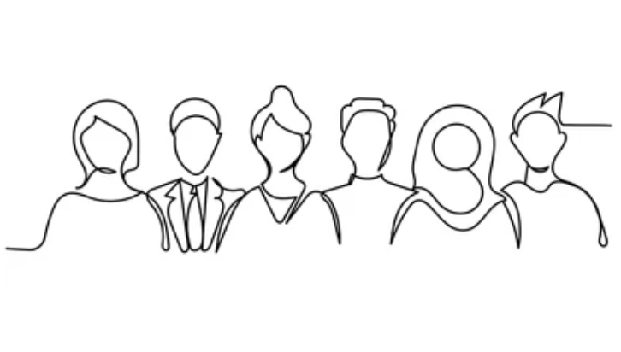
Does Perceived Discrimination Moderate the Impact of Diversity Statements on Pro-Diversity Attitudes and Behaviours?
47th International Conference on Gender, Justice and Futures – ICMS 47 Brussels
Ottilie Tilston¹, Julia Oberlin² & Soha Abboud²
¹ University of Lausanne, Switzerland,
² Université Libre de Bruxelles, Belgium
Notes:
Project in collaboration with two discrimination scholars at ULB
26.03.26

Slide 2
Outline
Introduction
Project rationale
Design of new study
Next steps
Notes:
haven't done data collection yet
still finalising the design
time to implement your wonderful feedback

Slide 3
Introduction
Workplace inequality exists (OECD, 2025).
Organizations attempt to address this through diversity, equity and inclusion (DEI) measures
(Pew, 2023) that typically consist of:
    DEI communications such as general diversity statements (via website)
    DEI initiatives (trainings, workshops, mentoring programs etc.) (Gündemir et al., 2024)
  Context - Current backlash against DEI
  Major companies ending initiatives (Meta, Google, Goldman Sachs and McDonalds (BBC, 2025)
  Ending “illegal DEI” and “restoring merit-based opportunity” (White house communications, 2026)
  Why?
Notes:
Lack of diversity especially on top leadership levels.
These type of interventions gradually becoming more popular and reached a peak in 2020 linked to the BLM movement
However, you might be aware that…
mainly contained to the US
but evidence that DEI is losing popularity in Europe too
→ and people from historically advantaged groups are reporting more discrimination than ever before
--> what is going on?
Particularly in finance and tech sectors
2023 positive discrimination no longer possible to be used in college admissions

Slide 4
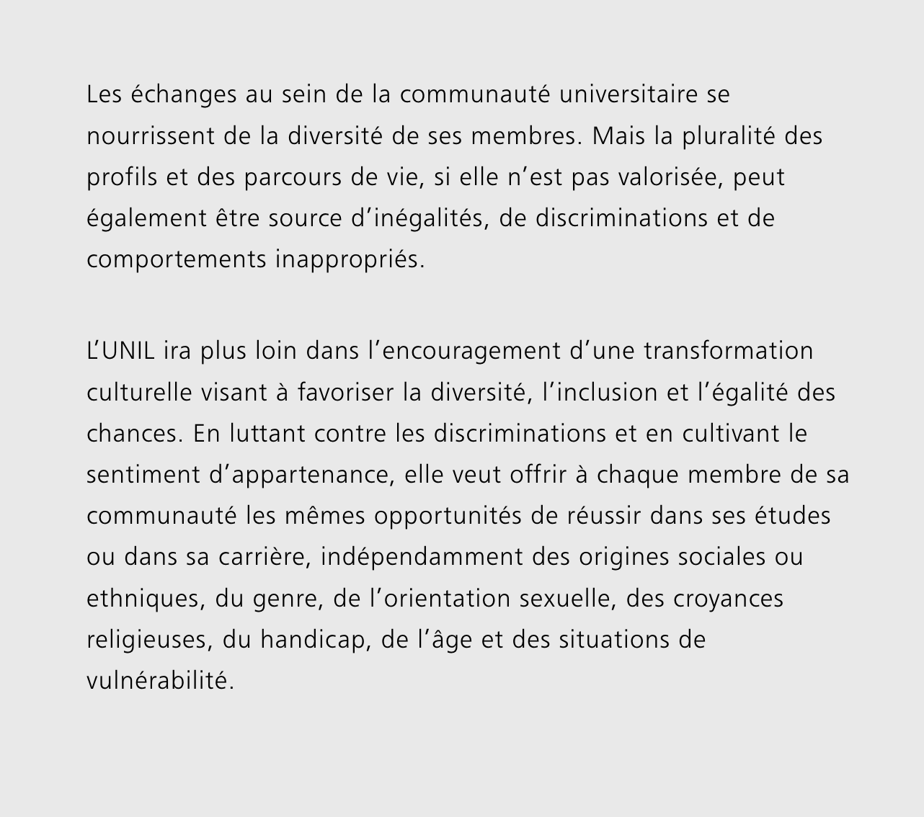
UNIL’s diversity statement
EDI commitments:
Ensuring inclusion
Combating inequality and discrimination
Pursuing cultural transformation
University of Lausanne (2022). Preparing for tomorrow 2021-2026, Statement of Intent of the Rectorate of the University of Lausanne, p. 10.
Notes:
What better example –
There is a lot on UNIL website
Take a moment to think to yourselves… has this statement made a difference, does it reflect what is really going on here?
Which leads me to my next question

Slide 5
Do diversity statements work?
Potential benefits:
    Increased belonging and job satisfaction among diverse employees (Mor Barak et al., 2016)
Organizations with diversity statements tend to be perceived as:
    fairer (Brady et al., 2015) and more prestigious (Bear et al., 2010)
  However,
    Fairness “illusion” – can cause discrimination blindness (Kaiser et al., 2013)
    Little impact on actual behaviours (Moser & Branscombe, 2023)
    Can deter (Leibbrandt & List, 2025)
Notes:
can be explained by Social Exchange Theory (people respond to positive actions with positive behaviours)
From my reading – diversity statements don’t tend to work
Neither do diversity trainings – forcing attendance often met with resistance that increases animosity
negative framing, people made aware of unconscious biases
Even if people do go, evidence that the effects of the trainings tend to be lost after a few days
These positive effects can be explained by Social Exchange Theory (Cropanzano and Mitchell 2005; Settoon et al. 1996), which posits that social interactions operate on the principle of reciprocity, where individuals respond to positive actions with positive behaviors (Emerson, 1976).
Leads people to believe their organization is procedurally just, even when they are presented with evidence of discrimination
Further, advantaged group members are more likely to de-legitimize and downplay discrimination claims from
underrepresented groups when an organization has (vs. does not have) diversity initiatives in place (Brady et al., 2015).

Slide 6
What is pro-diversity behaviour?
Actions that help create a more equitable environment (Zirn & Wisshak, 2025).
    For example:
    Increasing your own awareness about diversity issues
    Listening actively and respectfully to minority perspectives / viewpoints
    Advocating for fair treatment, recruitment and promotion of underrepresented candidates
    Challenging discriminatory or exclusionary conduct
However, in studies:
Only self-reported attitudes usually measured
willingness or intentions to help (e.g. Kende et al., 2017)
Research measuring actual behaviour is rare (Gündemir et al., 2024)
Vocal support for diversity often coincides with lack of action (Brown & Jacoby-Senghor, 2022)
Notes:
quite difficult to measure
often as a result of holding pro-diversity attitudes
Intentions to volunteer, hypothetical funding
Lending of phone, giving directions
→ This is a huge problem because
Some employees hold simultaneously both supportive and resistant attitudes
Zirn, F. L., & Wisshak, S. (2025). The impact of diversity training on workplace behavior–a meta-analysis. Journal of Workplace Learning, 37(7-8), 505-522.

Slide 7
Reactions to diversity statements
Diversity statements are signals (Signaling theory, Spence, 1973; Li et al., 2024) that individuals interpret differently (Dover et al., 2020; Drover et al., 2018).
On basis of their social identity / group membership (Kromidha & Robson, 2016)
  → i.e., belonging to an advantaged or disadvantaged group
Members of disadvantaged groups typically display less opposition to DEI than members of historically advantaged groups (Dover et al., 2016; Hsu & Riccucci, 2025; Leslie, 2019).
We argue this may depend on perceived discrimination
→ Different understandings of the nature of discrimination → ascribe different meanings → different psychological & behavioural outcomes (Tost et al., 2022).
Notes:
Why do some individuals react more positively to diversity statements than others?
(e.g., ethnic minorities and women) (e.g., white people and men)
Structural advantage, historical societal advantage
Women can be prejudiced and discriminate against men in individual interactions, but as a group they have not collectively denied men their civil rights
our idea: this is the mechanism:
Individuals / organizations convey signals about their intentions in order to shape perceptions and influence decisions, especially when direct information is costly to obtain

Slide 8
Perceived discrimination: Disadvantaged group members
Perceive and report discrimination that is more pervasive
widespread, frequent, systematic, affecting many areas of life
highly detrimental to psychological wellbeing (Schmitt et al., 2002)
Subsequently strengthens ingroup identification
(Rejection identification model, Branscombe et al., 1999).
Identify more strongly with similarly stigmatized others
(Frable et al., 1998; Gaertner et al., 1993; McKenna & Bargh, 1998)
Help others like themselves on the basis of perceived similarity
(Destro et al., 2024; Politi et al., 2023; Sinclair et al., 2024)
Individual mobility
Notes:
So what does this mechanism look like for disadvantaged group members?
Imagine you are a woman
At work, at home, in the street, tv – you feel systematically devalued and marginalized by sociaety
Mere presence of other minorities in the room can boost wellbeing
The Common Ingroup Identity Model Gaertner et al., 1993
Studies on affirmative action / Soha
--> if you are a minority, feeling discriminated --> support DEI
They may help others like themselves, motivated by perceived similarity (Frable et al., 1998; Sinclair et al., 2024)

Slide 9
Perceived discrimination: Advantaged group members
>50% of white Americans (Pew, 2024) and 2/3 of American men (Cassino, 2016) perceive at least some discrimination against them.
    legal cases: RAF in UK – hiring unlawful against men (2023)
Reverse discrimination (Nittrouer et al., 2024); High psychological entitlement (Campbell et al., 2004)
E.g., employment quotas (Fric & Galli da Bino, 2018; Tost et al., 2022)
Tends to be less pervasive:
(i.e., less severe, more context-dependent and easy to avoid)
→ Carries fewer implications for the individual’s value & status within the culture as a whole
Less pervasive → less psychological impact → less identification with minorities
(Schmitt et al., 2014; Tost et al., 2022)
Higher levels of psychological entitlement (Campbell et al., 2004)
Notes:
What about advantaged group members?
actually reporting more discrimination than ever before
Unpleasant experiences BUT Not devalued by society in general
= the unfair treatment of members of a historically advantaged group with the aim of correcting for previous discrimination against a historically disadvantaged group
SO DOESN`T LEAD TO IDENTIFY WITH MINORITIES
discrimination doesn't lead to more support for DEI
Women’s workplace advances as unfairly coming at the expense of men (e.g., Bosson et al., 2012; Kehn & Ruthig, 2013).
By asserting some level of equivalence in claiming they are discriminated against too, the meaning ascribed to the discriminatory event therefore leaves self esteem intact and does not lead to an increased sense of identification with their own, or any other group.
Additionally, advantaged group members are more likely to find DEI initiatives (symbolically and realistically) threatening due to fundamental misunderstandings about the nature of inequality (Brown et al., 2022; Kraus et al., 2017; Wilkins et al., 2015). This may explain why members of advantaged groups are more likely to react negatively to DEI initiatives (Dover et al., 2016; Gündemir et al., 2024) and also display less helping behaviours (Hsu & Riccucci, 2025; Kanitz et al., 2024). We suggest that this mechanism is likely to be particularly pronounced in advantaged group members that perceive high levels of discrimination.
Women attribute workplace discrimination to lack of fit / suitability due to patriarchal norms (i.e., that masculine traits are more valued than feminine traits)
Men’s workplace discrimination is about quotas – says little about men’s abilities and so doesn’t affect their self-efficacy
Free generation of narratives as to why they feel discriminated
Reduces bothmen’s and women’s sense of belonging in the workplace. negative effect on well-being being more pronounced among women than among men

Slide 10
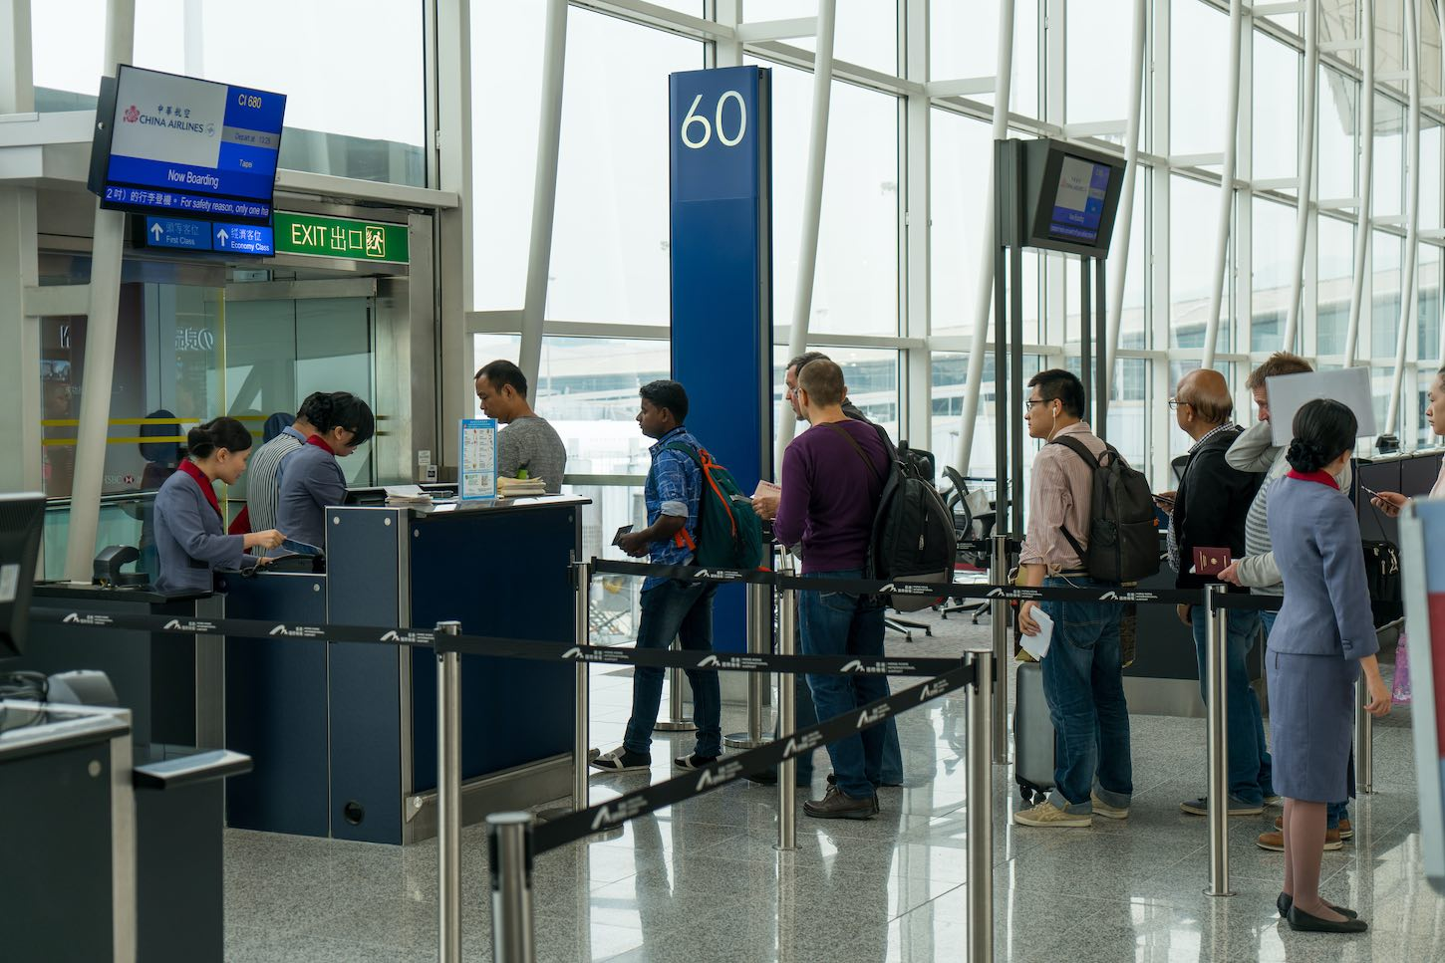
Perceived discrimination: Advantaged group members (cont.)
Why might advantaged group members perceive discrimination differently?
Higher levels of psychological entitlement (Campbell et al., 2004)
→ may lead to detection of higher levels of discrimination (Steel & Paier, 2022)
Beliefs about meritocracy
Experience of discrimination itself psychological mechanism:
to alleviate guilt (Phillips & Lowery, 2020)
to externalise blame (Crocker & Major, 1989)
about social equalities
Intergroup threat (Iyer, 2002)
(Steel & Paier, 2022)
Notes:
Other theoretical background here, important to mention...
Robust - Believe that they deserve more benefits, expect to be treated accordingly
Feel entitled to things they take for granted such as:
→ Visibility, sense of belonging, freedom of movement
- There must be a reason why I am in the business line * I deserve
- Asked to step out of the business line - discrimination
Makes advantaged groups more sensitive to discrimination
I am a victim too
can include self-worth, visibility, positive expectations, psychological freedom from the tether of race, freedom of movement, sense of belonging & sense of entitlement

Slide 11
Model
→ We therefore propose that the attitudes and behaviour an individual shows in response to a diversity statement is moderated by group membership and this relationship is moderated by perceived discrimination
Membership to advantaged vs disadvantaged group
Perceived Discrimination
DEI Communication
^{(diversity statement)}
Pro-DEI Attitudes and Behaviors
Notes:
→ We therefore propose that the attitudes and behaviour an individual shows in response to a diversity statement is moderated by perceived discrimination levels and whether one belongs to an advantaged or disadvantaged group.

Slide 12
Hypotheses
Hypothesis 1:
Disadvantaged group members will demonstrate more positive pro-diversity attitudes and behaviours after reading the diversity statement than advantaged group members.
Hypothesis 2:
Pervasiveness of perceived discrimination felt will interact with pro-diversity attitudes and behaviour
Hypothesis 3:
Advantaged group members who perceive high discrimination will exhibit more negative pro-diversity attitudes and behaviours after reading the diversity statement compared to advantaged group members who perceive low discrimination.
Hypothesis 4:
Disadvantaged group members who perceive high discrimination will demonstrate more positive pro-diversity attitudes and behaviours after reading the diversity statement compared to disadvantaged group members who perceive low discrimination.
Notes:
In other words:
H1, minorities will react more positively to the diversity statement than non-minorities.
H2 how an individual reacts depends on how pervasive they think the discrimination is against them
H3 people from the majority group who perceive high discrimination will react more negatively to the statement than those who do not think they are being discriminated against
H4 minority people who perceive high discrimination will react more positively to the statement than those who don’t perceive discrimination
Disadvantaged group members will report discrimination that is more pervasive than advantaged group members.
Hypothesis 1: Advantaged group members who perceive high discrimination will display more negative attitudes to DEI after reading the diversity statement than advantaged group members who perceive low discrimination.
Hypothesis 2: Advantaged group members who perceive high discrimination will display less prodiversity behaviour after reading the diversity statement than advantaged group members who perceive low discrimination.
Hypothesis 3: Disadvantaged group members who perceive high discrimination will display more positive attitudes to DEI after reading the diversity statement than disadvantaged group members who perceive low discrimination
Hypothesis 4: Disadvantaged group members who perceive high discrimination will display more prodiversity behaviour after reading the diversity statement than disadvantaged group members who perceive low discrimination

Slide 13
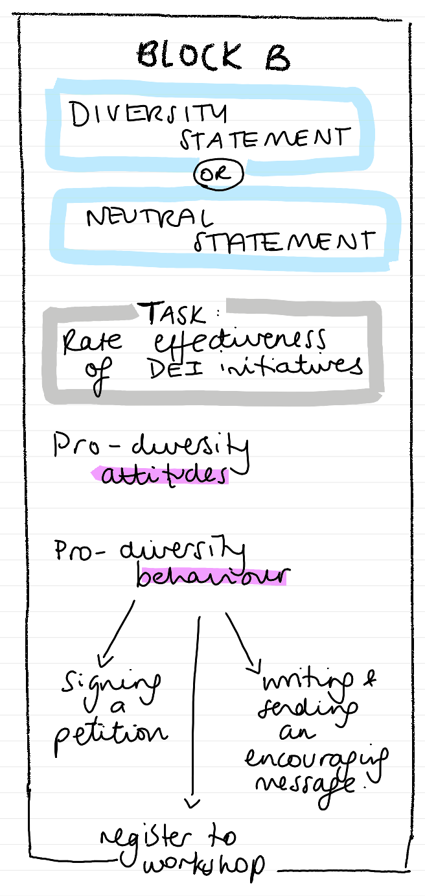
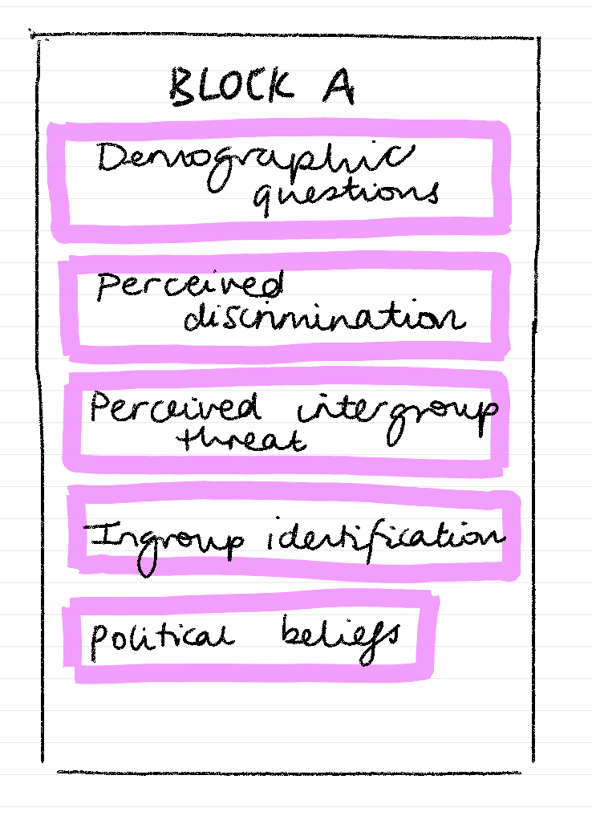
Study design
Online 2 part study – Prolific,
480 participants
(50% women, 50% ethnic minorities)
Short preselection questionnaire
Two-part survey with two counterbalanced blocks (15 mins) two weeks apart.
controls & moderators
main IV and DVs
Notes:
general background items (e.g. gender identity, nationality, ethnic background, year of study they are in, how often they come to campus).
REDUCTION : male / female : Majority / minority
In order to get split...
All pink items counterbalanced within the blocks as well as the blocks themselves
A lot of controls
ALSO intergroup contact
Ingroup identification is important to perceived discrimination
Block A will contain control and mediating variables:
demographic questions
measures of perceived discrimination
perceived intergroup threat
ingroup identification
political beliefs.
Social desirability measure?
Block B will contain the main manipulation: showing participants a diversity statement or a neutral statement, and then measuring their attitudes towards diversity and inclusion, (intention to support minorities) and also their actual behaviour towards minorities (whether or not they choose to sign a petition and write an encouraging message to a real minority worker-participants will be notified that half of these messages will actually be sent).

Slide 14
Block A: Measures
Age, gender, ethnicity
Will also collect sexual orientation, nationality, first language, immigration status, education level, job position, disability condition, asked whether they belong to a disadvantaged community.
Perceived discrimination
Past experience of discrimination (Schmitt et al., 2002)
Perceived intergroup threat
Using Iyer’s (2022) framework to assess a) resource threats, b) symbolic threats, and c) in-group morality threats.
Ingroup identification
Inclusion of the ingroup in the self scale (Tropp & Wright, 2001)
Once for gender, once for ethnic group
Political beliefs
Intergroup contact
Notes:
Here's an overview of the measures in Block A
Go into each of them in detail

Slide 15
Diversity Statement vs. Neutral Statement
Diversity statement | Neutral statement
Thanks for participating to our study. At the University of Lausanne and the Université Libre de Bruxelles, we are committed to fostering an inclusive environment that values and respects the diverse backgrounds, experiences, and perspectives of all individuals. We aim to promote fairness, equity, and greater inclusivity in our work. Your responses will help us gain valuable insights into these important topics. We want to assure you that your participation is greatly appreciated and that your perspectives contribute significantly to making research more representative and impactful for everyone. | Thanks for participating to our study. At the University of Lausanne and the Université Libre de Bruxelles, we are committed to fostering an academically competent environment where different types of research are conducted and a broad range of topics are explored. We aim to promote precision, rigor and greater reflexivity in our work. Your responses will help us gain valuable insights into these important topics. We want to assure you that your participation is greatly appreciated and that your perspectives contribute significantly to improving and advancing research.
Notes:
Moving onto Block B (with manipulation and dependent variables)
In the context of them working as a prolific worker for us
emphasis on:
diversity
scientific rigor

Slide 16
Task (Block B)
As a member of the university community, we are interested to know how you think that the University should spend it’s budget. If you had 100% of the University’s leftover Budget to spend, how would you allocate between the following options (input percentage):
Building and outdoor garden maintenance
Marketing and communications (e.g. social media)
Extracurricular activities for students (e.g. sports centre)
Career services for students
Diversity and inclusion office and services for students
Sustainability initiatives (e.g. energy efficiency)
Notes:
Add a manipulation check - where?

Slide 17
Dependent variables (Block B)
Pro-diversity attitudes
  General: Benefits and Threats of Diversity Scale (adapted from Hofhuis et al., 2015).
  E.g., “Initiatives promoting best practices regarding diversity, equity and inclusion are a good idea”
  Willingness to help: Attitudes Towards DEI Training scale (Gans & Zhan, 2023)
  E.g., “I intend to participate in my organization’s DEI initiatives in the future”
  Pro-diversity behaviour
  Sign a pro-diversity petition (measure signups to real petition)
  Register to workshop (measure signups and attendance to real workshop)
  Write a welcoming message to a minority student (X% will really be sent)
Notes:
Add a manipulation check - where?

Slide 18
Analysis
Initial model = Model 3 in Hayes Process
Including controls = Moderated multiple regression (MMR) analysis:
Y (Pro-diversity outcome variable) =
β₀ (Intercept) + β₁X₁ (advantage or disadvantage) + β₂X₂ (perceived discrimination) + β₃X₃ (diversity statement) + β₄(X₁ * X₃) (Interaction advantage * statement) + β₅(X₂ * X₃) (Interaction perceived discrimination * statement) + β₆X₄ (political beliefs) + β₇X₅ (education level) + β₈X₆ (pervasiveness) + ε (Error term)
Run separately:
for each DV: once for attitudes and then once for behaviour
for each type of advantage: once for gender advantage and once for ethnic advantage
Control variables: political beliefs, education level, pervasiveness, ingroup identification, perceived intergroup threat, intergroup contact
Notes:
Y = β₀ + β₁X₁ + β₂X₂ + β₃X₃ + β₄(X₁ * X₃) + β₅(X₂ * X₃) + ε
Where:
Y = Pro-diversity attitudes (continuous scale)
β₀ = Intercept
β₁, β₂, β₃, β₄, β₅ = Coefficients for each predictor and interaction term
X₁ = Membership to advantaged vs. disadvantaged group (0/1)
X₂ = Perceived discrimination (continuous scale 1-7)
X₃ = Seeing a diversity statement (0/1)
ε = Error term

Slide 19
Next steps
Implement your feedback
Later this academic year (Autumn semester): Run the study
Submit manuscript to Equality Diversity and Inclusion Journal (EDI)
Create follow-up studies looking at better methods of DEI communication
  e.g. social norms messaging intervention idea
  Intergroup contact, increasing social accountability
Notes:
Preregister hypotheses
Get ethical approval

Slide 20
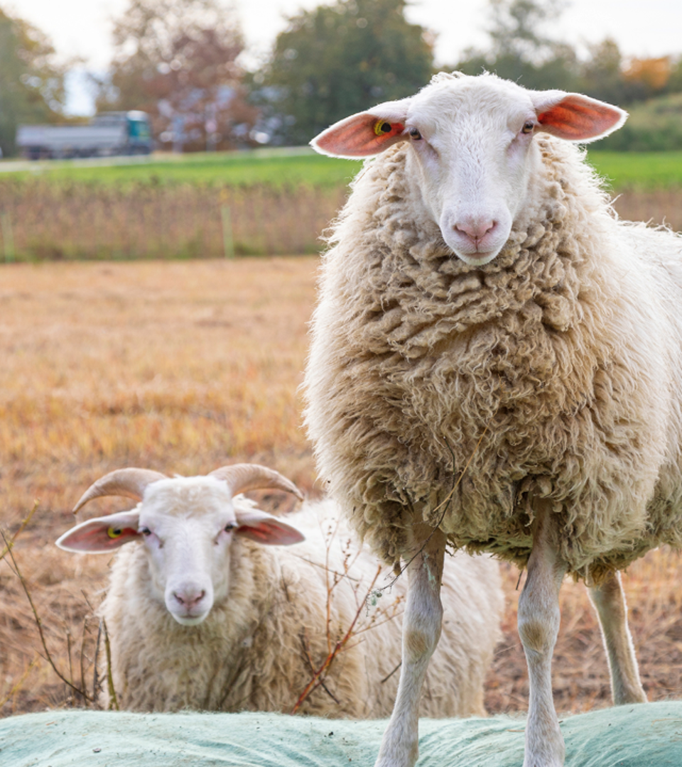
Thanks for your attention
I welcome your questions
and comments
ottilie.tilston@unil.ch

Slide 21
References
Bear, S., Rahman, N., & Post, C. (2010, August). Diversity drivers: How gender composition and director resource diversity affect corporate social responsibility and reputation. In Academy of Management Proceedings (Vol. 2010, No. 1, pp. 1-6). Briarcliff Manor, NY 10510: Academy of Management.
Brady, L. M., Kaiser, C. R., Major, B., & Kirby, T. A. (2015). It's fair for us: Diversity structures cause women to legitimize discrimination. Journal of Experimental Social Psychology, 57, 100-110.
Branscombe, N. R., Schmitt, M. T., & Harvey, R. D. (1999). Perceiving pervasive discrimination among African Americans: implications for group identification and well-being. Journal of Personality and Social Psychology, 77(1), 135.
Brown, N. D., & Jacoby-Senghor, D. S. (2022). Majority members misperceive even “win-win” diversity policies as unbeneficial to them. Journal of Personality and Social Psychology, 122(6), 1075.
Campbell, W. K., Bonacci, A. M., Shelton, J., Exline, J. J., & Bushman, B. J. (2004). Psychological entitlement: Interpersonal consequences and validation of a self-report measure. Journal of Personality Assessment, 83(1), 29-45.
Cassino, D. (2016). Why more American men feel discriminated against. Harvard Business Review. https://hbr.org/2016/09/why-more-american-men-feel-discriminated-against
Crocker, J., & Major, B. (1989). Social stigma and self-esteem: The self-protective properties of stigma. Psychological Review, 96(4), 608.
Drenon, B., “In the US, DEI is under attack. But under a different name, it might live on” BBC, 2025, https://www.bbc.com/news/articles/c24110m30ddo
Destro, C. L., Rullo, M., Telesca, G., & Visintin, E. P. (2024). Supporting Ukrainian refugees: Examining intergroup contact, empathy and European identity in promoting helping behaviours. Journal of Community and Applied Social Psychology, 34(5), e2869.
Dover, T. L., Kaiser, C. R., & Major, B. (2020). Mixed signals: The unintended effects of diversity initiatives. Social Issues and Policy Review, 14(1), 152-181.
Dover, T. L., Major, B., & Kaiser, C. R. (2016). Members of high-status groups are threatened by pro-diversity organizational messages. Journal of Experimental Social Psychology, 62, 58-67.
Drover, W., Wood, M. S., & Corbett, A. C. (2018). Toward a cognitive view of signalling theory: Individual attention and signal set interpretation. Journal of Management Studies, 55(2), 209-231.
Eurofound (Fric, K., & Galli da Bino, C.) (2018), Discrimination against men at work: Experiences in five countries, Publications Office of the European Union, Luxembourg.
Foster, M. D., Jackson, L. C., Hartmann, R., & Woulfe, S. (2004). Minimizing the pervasiveness of women's personal experiences of gender discrimination. Psychology of Women Quarterly, 28(3), 224-232.
Frable, D., Pratt, L., & Hoey, S. (1998). Concealable stigmas and positive self-perceptions: Feeling better around similar others. Journal of Personality and Social Psychology, 74(4), 909-922.
Gaertner, S. L., Dovidio, J. F., Anastasio, P. A., Bachman, B. A., & Rust, M. C. (1993). The common ingroup identity model: Recategorization and the reduction of intergroup bias. European Review of Social Psychology, 4(1), 1-26.
Gans, R., & Monica Zhan, M. (2023). Let’s influence that attitude before it’s formed: Inoculation against reactance to promote DEI training. International Journal of Business Communication, 23294884231216952.
Graham, J., Haidt, J., & Nosek, B. A. (2009). Liberals and conservatives rely on different sets of moral foundations. Journal of Personality and Social Psychology, 96(5), 1029.
Gündemir, S., Kanitz, R., Rink, F., Hoever, I. J., & Slepian, M. L. (2024). Beneath the surface: Resistance to diversity, equity, and inclusion (DEI) initiatives in organizations. Current Opinion in Psychology, 60, 101922.
Hofhuis, J., van der Zee, K. I., & Otten, S. (2015). Measuring employee perception on the effects of cultural diversity at work: Development of the benefits and threats of diversity scale. Quality & Quantity, 49(1), 177-201.
Hsu, H. Y., & Riccucci, N. M. (2025). Support for affirmative action in the workplace: gender, race, and sector differences. Review of Public Personnel Administration, 45(2), 399-418.
Iyer, A. (2022). Understanding advantaged groups' opposition to diversity, equity, and inclusion (DEI) policies: The role of perceived threat. Social and Personality Psychology Compass, 16(5), e12666.
Kalev, A., Dobbin, F., & Kelly, E. (2006). Best practices or best guesses? Assessing the efficacy of corporate affirmative action and diversity policies. American Sociological Review, 71(4), 589-617.
Kende, A., Lantos, N. A., Belinszky, A., Csaba, S., & Lukács, Z. A. (2017). The politicized motivations of volunteers in the refugee crisis: Intergroup helping as the means to achieve social change. Journal of Social and Political Psychology, 5(1), 260-281.
Notes:
Ask Soha about Nittrouer et al., 2024 study

Slide 22
References
Kaiser, C. R., Major, B., Jurcevic, I., Dover, T. L., Brady, L. M., & Shapiro, J. R. (2013). Presumed fair: ironic effects of organizational diversity structures. Journal of Personality and Social Psychology, 104(3), 504.
Leibbrandt, A., & List, J. A. (2025). Do equal employment opportunity statements encourage racial minorities? evidence from a large natural field experiment. European Economic Review, 174, 104987.
Li, F., Lo, C. K., Tang, C. S., & Zhou, P. (2025). Will diversity, equity, and inclusion commitment improve manufacturing firms’ market performance? A signaling theory perspective on DEI announcements. Production and Operations Management, 34(3), 331-342.
Lynch, F. R. (1989). Invisible victims: White males and the crisis of affirmative action. Greenwood Press.
Moser, C. E., & Branscombe, N. R. (2023). Communicating inclusion: How men and women perceive interpersonal versus organizational gender equality messages. Psychology of Women Quarterly, 47(2), 250-265.
Mor Barak, M. E., Lizano, E. L., Kim, A., Duan, L., Rhee, M. K., Hsiao, H. Y., & Brimhall, K. C. (2016). The promise of diversity management for climate of inclusion: A state-of-the-art review and meta-analysis. Human Service Organizations: Management, Leadership and Governance, 40(4), 305-333.
Pew Research Center, April 2024, “Rising Numbers of Americans Say Jews and Muslims Face a Lot of Discrimination”. The American Trends Panel survey.
Pew Research Center, May 2023, “Diversity, Equity and Inclusion in the Workplace”. The American Trends Panel survey.
Phillips, L. T., & Lowery, B. S. (2020). I ain’t no fortunate one: On the motivated denial of class privilege. Journal of Personality and Social Psychology, 119(6), 1403.
Politi, E., Gale, J., Roblain, A., Bobowik, M., & Green, E. G. (2023). Who is willing to help Ukrainian refugees and why? The role of individual prosocial dispositions and superordinate European identity. Journal of Community & Applied Social Psychology, 33(4), 940-953.
Schmitt, M. T., Branscombe, N. R., Kobrynowicz, D., & Owen, S. (2002). Perceiving discrimination against one’s gender group has different implications for well-being in women and men. Personality and Social Psychology Bulletin, 28(2), 197-210.
Schmitt, M. T., Branscombe, N. R., Postmes, T., & Garcia, A. (2014). The consequences of perceived discrimination for psychological well-being: a meta-analytic review. Psychological Bulletin, 140(4), 921.
Sinclair, S., Granberg, M., & Nilsson, T. (2024). Love thy (Ukrainian) neighbour: Willingness to help refugees depends on their origin and is mediated by perceptions of similarity and threat. British Journal of Social Psychology, 63(2), 499-517.
Steel, D., & Paier, K. (2022). Pro-diversity beliefs and the diverse person’s burden. Synthese, 200(5), 357.
Tost, L. P., Hardin, A. E., Roberson, J. W., & Gino, F. (2022). Different roots, different fruits: Gender-based differences in cultural narratives about perceived discrimination produce divergent psychological consequences. Academy of Management Journal, 65(6), 1804-1834.
Tropp, L. R., & Wright, S. C. (2001). Ingroup identification as the inclusion of ingroup in the self. Personality and Social Psychology Bulletin, 27(5), 585-600.
White House Communications, 2025. “Ending illegal discrimination and restoring merit-based opportunity” https://www.whitehouse.gov/presidential-actions/2025/01/ending-illegal-discrimination-and-restoring-merit-based-opportunity/
Zirn, F. L., & Wisshak, S. (2025). The impact of diversity training on workplace behavior–a meta-analysis. Journal of Workplace Learning, 37(7-8), 505-522.
Notes:
Ask Soha about Nittrouer et al., 2024 study

Slide 23
Measures: Demographics (Block A)
Dimension | Content | Values Coding
Prolific ID | What is your Prolific ID? | Short text field
Age | How old are you? | Digital Input
Gender identity | What is your gender identity? | Woman; Man; Trans-Man; Trans-Woman; Non-binary/Third gender; I'd rather not answer
 | Prefer to self-identify: [Other] | Optional short text field
Sexual orientation | What is your sexual orientation? | Heterosexual; Homosexual; Bisexual; Asexual; I'd rather not answer
 | What is your sexual orientation? [Other] | Optional short text field
Nationality | What is your nationality? (If you have more than one, choose the one that best represents you) | 250 nationalities possible (drop-down list) or simply give short text field
First language learned | Please indicate the first language you learnt: | Short text field
Immigration status | Were you born in the country you are currently working in? | 0 = Yes; 1 = No (I moved to the country I am now working in)
 | Were you born in the country you are currently working in? [Other] | Optional short text field
Ethnicity | Please indicate your ethnicity (i.e., ethnicity describes the feeling of belonging and attachment to a distinct group of a larger population that shares their ancestry, color, language or religion)? | (Options for UK) White or Caucasian; Black, Black British, Caribbean or African; Asian or Asian British; Mixed or multiple ethnic groups, Any other ethnic group (Optional short text field) Prefer not to say
 | Please indicate your ethnicity (i.e., ethnicity describes the feeling of belonging and attachment to a distinct group of a larger population that shares their ancestry, color, language or religion)? [Other]
Education level | Which of these is the highest level of education you have completed? | No formal qualifications; Secondary education; High-school diploma; Technical/community college; Undergraduate degree (e.g., bachelor’s degree); Graduate degree (e.g., master's degree); Doctorate degree (e.g., PhD); I'd rather not answer
 | Which of these is the highest level of education you have completed? [Other] | Optional short text field
Job position | What is your position in your organization? | Top Manager/CEO; Middle-Manager; Diversity Manager; Employee
 | What is your position in your organization? [Other] | Optional short text field
Disability condition | If you are comfortable enough to answer this question, do you consider yourself as having a visible or invisible disability? | Yes; N/A; No
Disadvantaged communities | Please indicate which, if any, of the following communities you identify as part of: (check all that apply) | The LGBTQ+ community; People of color; Immigrants; Children of immigrants; First-generation college students; The disability community; Transgender or gender queer community; Women in male-dominated fields; Veterans or Armed Services community; Religious minority community (please specify religion) (→optional short text field)
Notes:
This is exactly how we will ask the demographics
Use gender and ethnicity to categorise M/F, Maj/Min
Rest - important to know
First generation or second generation immigrant (can tell by immigration status)

Slide 24
Measures: Subjective status Scale
Subjective Status Scale.
“In our society and in our workplaces, some groups are advantaged and hold more power, while others are disadvantaged and have less access to power. In general, the latter groups suffer from discrimination, exclusion, and less access to resources and opportunities. In this section, we would like to know whether you feel part of an advantaged or disadvantaged group in society and in your organization.”
Items in table will be subsequently recoded and averaged to produce a single Subjective Status score.
Participants who score 4 or higher on the disadvantaged items will then be asked to identify the source(s) of their perceived disadvantage.
Based on your own perceptions and experiences, which attributes make you feel different from those who are advantaged at your workplace?
        My race or ethnicity;
        My gender identity;
        Other (open-ended response)
Subjective Status (α = .88) | Items
In Society (α = .83) | In society, in general, I feel favored or advantaged In society, in general, I feel disadvantaged or stigmatized My life is negatively affected (by my group memberships) My life is positively affected (by my group memberships)
In the Workplace (α = .81) | In my workplace, I feel favored or advantaged In my workplace, I feel disadvantaged or stigmatized My career is negatively affected (by my group memberships) My career is positively affected (by my group memberships)
(Oberlin, Toma & Dover, under review)
^{[1]} Täuber, S. (2022). “Women academics’ intersectional experiences of policy ineffectiveness in the European context”, Frontiers in Psychology, Vol. 13, p. 2275. doi:10.3389/fpsyg.2022.810569
Notes:
One of two ways we are measuring percieved discrimination
We are
How advantaged do they feel ?
Our intent was to capture a general sense of perceived disadvantage, rather than a context-specific perception that might be too closely tied to DEI practices in the workplace.
Drawing from Tauber’s (2022) Intersectionality Scale^{[1]},
Based on your own perceptions and experiences, which attributes make you feel different from those who are advantaged at your workplace? (If you feel you do not differ in any way, please tick the last box).” Response options include: My race or ethnicity; My country of origin; My legal sex; My gender identity; My sexual orientation; My age (relative to my peers); My disability status; My social class; My religious affiliation (or lack thereof); None of these attributes make me feel different; and Other (open-ended response).

Slide 25
Measures: Experience of discrimination
“I have personally been a victim of discrimination because of my gender/ ethnic group”
“I consider myself a person who has been deprived of opportunities because of my gender / ethnic group,”
“I feel like I am personally a victim of society because of my gender / ethnic group”
“I have personally been the victim of harassment because of my gender / ethnic group,”
“I regularly encounter sexism / racism against my gender / ethnic group”
“Prejudice against my gender / ethnic group has affected me personally”
1 to 7 scale (strongly disagree to strongly agree) (Adapted from Schmitt et al., 2002)
Measures of pervasiveness
Across time:
To what degree do you think you are likely to be discriminated against again in the future?
Across contexts:
To what degree would discrimination be likely to affect other areas of your life or happen in other situations?
1 to 7 scale (not at all likely to extremely likely) (Foster, Jackson, Hartmann, & Woulfe, 2004)
Open question – describe the type of discrimination you experience
^{[1]} Täuber, S. (2022). “Women academics’ intersectional experiences of policy ineffectiveness in the European context”, Frontiers in Psychology, Vol. 13, p. 2275. doi:10.3389/fpsyg.2022.810569
Notes:
More about discrimination
Ask them once for gender and once for ethnic group
Comment from Julia - For age too? Idea to add item at the end “I feel discriminated against for a different reason” Open box
Our intent was to capture a general sense of perceived disadvantage, rather than a context-specific perception that might be too closely tied to DEI practices in the workplace.
Drawing from Tauber’s (2022) Intersectionality Scale^{[1]},
This measure was reliable overall (α = .82) and for both women (α = .81) and men (α = .77).

Slide 26
Measures: Perceived Intergroup Threat
Companies often put in place Diversity Equity and Inclusion (DEI) initiatives (such as implicit bias trainings, workshops, events and mentoring programs) in order to address workplace inequalities.
We are interested to know how you feel about this:
Perceived Intergroup Threat (α = .92) | Items
Resource Threat (α = .78) | I feel that DEI initiatives would increase the opportunities available to people like me in my organization. I am concerned that DEI initiatives would limit the resources available to my group. I worry that DEI initiatives would divert resources away from my team or department.
Symbolic Threat (α = .82) | I am concerned that DEI practices would change the fundamental values of my organization in a way I do not support. I feel that DEI practices would strengthen the cultural norms that I value in our workplace. I worry that DEI practices would undermine the traditions of my organization.
Ingroup Morality Threat (α = .81) | I feel that DEI initiatives would unfairly blame people like me for the existing bias and inequalities. I think that DEI initiatives would help others to see my group positively. I worry that DEI initiatives would make my group look morally wrong.
(Oberlin, Toma & Dover, under review)
^{[1]} Täuber, S. (2022). “Women academics’ intersectional experiences of policy ineffectiveness in the European context”, Frontiers in Psychology, Vol. 13, p. 2275. doi:10.3389/fpsyg.2022.810569
Notes:
Control or another potential moderator
Iyer identifies three types of threats that advantaged groups may experience in response to DEI initiatives: resource threat, the fear of losing access to opportunities and power; symbolic threat, the perception that DEI challenges cultural norms like meritocracy that have historically benefited them; and in-group morality threat, the discomfort arising from being made aware of their group’s role in social inequalities
Our intent was to capture a general sense of perceived disadvantage, rather than a context-specific perception that might be too closely tied to DEI practices in the workplace.
Drawing from Tauber’s (2022) Intersectionality Scale^{[1]},

Slide 27
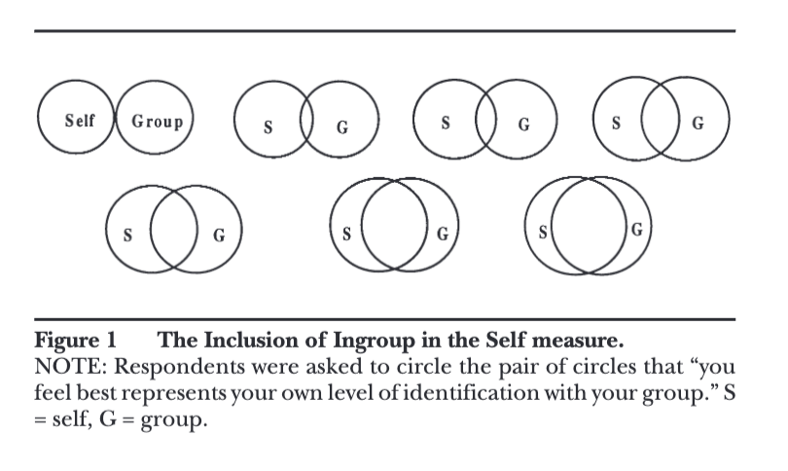
Ingroup identification
Control variables
Inclusion of the ingroup in the self scale (Tropp & Wright, 2001)
Once for gender group, once for ethnic group
Political beliefs
How do you identify politically?
7-point scale anchored by strongly liberal and strongly conservative, with moderate at the midpoint (Graham et al., 2009)
Intergroup contact
How much everyday contact do you have:
      with the opposite gender?
      with ethnic majority group members
      with ethnic minority group members 7-point scale (No contact – Occasional – Constant)
Notes:
Important things that might affect someone's baseline attitude to DEI
Better measure of intergroup contact?
Graham, J., Haidt, J., & Nosek, B. A. (2009). Liberals and conservatives rely on different sets of moral foundations.Journal of Personality and Social Psychology, 96(5), 1029–1046. https://doi.org/10.1037/a0015141
Our intent was to capture a general sense of perceived disadvantage, rather than a context-specific perception that might be too closely tied to DEI practices in the workplace.
Drawing from Tauber’s (2022) Intersectionality Scale^{[1]},

Slide 28
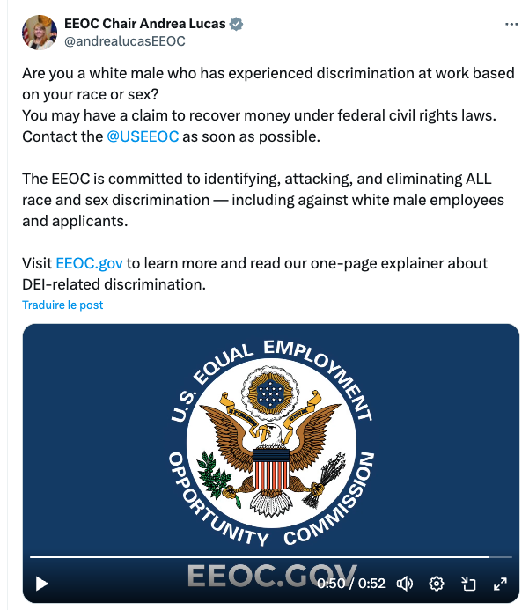
US gov, 2025-6
Notes:
chair of the Equal Employment Opportunity Commission (EEOC)

Slide 29

Extra slide, DiAngelo, 2018
Good / bad binary
Interpreting discussions about discrimination as personal accusations
False but widespread belief that discrimination can only be intentional
In fact, we are all socialised into a system of implict bias / stereotypes

